Slide 2
We are here to help !
ELENA

Slide 3
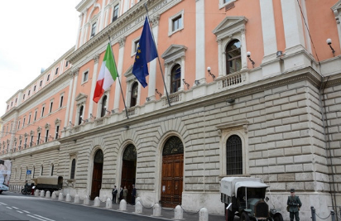
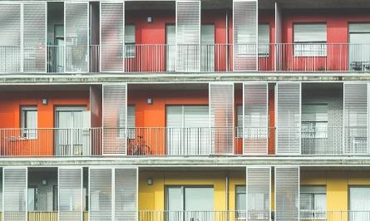
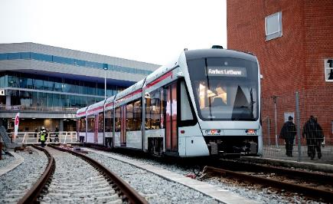
Investment Programme (IP)
Sustainable Energy
Residential
Urban transport
Building renovation (public & private)
Renewables in buildings:
Solar PV+WH
Biomass boilers
Street lighting
District/cooling heating networks
Smart grids
Housing renovation (private & social)
Integrated Renewables:
Solar PV
Solar WH
Biomass boilers
Heat pumps
Improved public transport and mobility
Electric buses
Charging stations
Alternative fuel vehicles
IT for model shift

Slide 4
Investment portfolio – Mix & Match
€100m
€90m
€80m
€70m
€60m
€50m
€40m
€30m
€20m
€10m
Public buildings
Street lighting
District heating
RE in buildings
RE in Housing
Housing
Public transport
EV charging points
Electric buses
Modal shift
ELENA

Slide 5
Investment portfolio – Participants & Timeline
Central government
Ministries
Regional government
Municipalities
One Stop Shop Private entity
Households
Bank
Businesses/SMEs
3/4 years
10 years
Public buildings
Housing
EV charging points
Street lighting

Slide 6
The Netherlands (Zuid-Holland) – Private (DH+HO)
Central government
Ministries
€100m
€90m
€80m
€70m
€60m
€50m
€40m
€30m
€20m
€10m
Regional government
Municipalities
One Stop Shop Private entity
Households
Bank
Businesses SMEs
Public buildings +RE
District heating
Green transport
Street lighting
Housing +RE
EV charging points
ELENA
Notes:
District Heating = EUR 40 m
EE in Residential buildings = 25 m
TOTAL IP = EUR 65 m
(on-going project / target to be missed (originally EUR 95 m) )

Slide 7
Belgium (FLESPI) – Public (regional+local)
Central government
Ministries
€100m
€90m
€80m
€70m
€60m
€50m
€40m
€30m
€20m
€10m
Regional government
Municipalities
One Stop Shop
Households
Bank
Businesses SMEs
Public buildings +RE
District heating
Green transport
Street lighting
Housing +RE
EV charging points
ELENA
Notes:
EE in public buildings (+RE) = EUR 27 m
EE in street lighting = EUR 85 m
TOTAL IP = EUR 112 m
(completed project / overachieved the IP target / mostly based on public tenders)

Slide 8
Slovenia (SMP Slovenia) – Public (transport)
Central government
Ministries
€100m
€90m
€80m
€70m
€60m
€50m
€40m
€30m
€20m
€10m

Regional government
Municipalities
One Stop Shop
Households
Bank
Businesses SMEs
Public buildings +RE
District heating
Green transport
Street lighting
Housing +RE
EV charging points
ELENA
Notes:
EV Charging Infrastructure = EUR 4.7 m
Green Transport = EUR 93.7 m
TOTAL IP = EUR 98.4 m
(on-going project / actual IP slightly behind target)

Slide 9
The Netherlands (ING Bank) – Private (buildings)
Central government
Ministries
€100m
€90m
€80m
€70m
€60m
€50m
€40m
€30m
€20m
€10m
Regional government
Municipalities
One Stop Shop
Households
Bank
Businesses SMEs
Public buildings +RE
District heating
Green transport
Street lighting
Housing +RE
EV charging points
ELENA
Notes:
EE in Commercial buildings (+RE) = EUR 45.5 m
EE in Residential buildings (+RE) = UER 52 m
TOTAL IP = EUR 97.5 m
(on-going project / actual IP behind target !)

Slide 10
What is your investment portfolio?
ELENA
YOU

Slide 11
Project Development Services (PDS)
Internal staff
Stakeholder engagement & co-ordination
Promotion & marketing
Feasibility & technical studies
Energy audits
Structuring, bundling & business plans
Tendering procedures & documentation
Legal/financial advisory
Project management
External experts
Above are examples, lists not exhaustive

Slide 12
Project Development Services – Mix & Match
Decide what you need to make the investment happen
Decide what you can do in-house and what to outsource
Engage
Promote
Energy audits
Tenders
Studies
Business plans
Financial Legal
Project mgt
ELENA

Slide 13
The Netherlands (Zuid-Holland) – Private (DH+HO)
Central government
Ministries
€4m
€3m
€2m
€1m
Regional government
Municipalities
One Stop Shop
Households
Bank
Businesses SMEs
Engage
Promote
Energy audits
Tenders
Studies
Business plans
Financial Legal
Project mgt
ELENA
Notes:
No in-house team (only 2 officers co-ordinating but not paid by ELENA) – all PDS outsourced via a ‘dynamic purchasing system’ where municipalities request services
Staff (green bubbles) = EUR 0
Consultants (blue bubbles) = EUR 3m
TOTAL PDS = EUR 3 m
ELENA = EUR 2.7 m

Slide 14
Belgium (FLESPI) – Public (regional+local)
Central government
Ministries
€4m
€3m
€2m
€1m
Regional government
Municipalities
One Stop Shop
Households
Bank
Businesses SMEs
Engage
Promote
Energy audits
Tenders
Studies
Business plans
Financial Legal
Project mgt
ELENA
Notes:
In-house team at OSS covering most PDS services (grew from 3 to 23 staff !
Staff (green bubbles) = EUR 2.6 m
Consultants (blue bubbles) = EUR 1.2 m
TOTAL PDS = EUR 3.8 m
ELENA = EUR 3.2 m

Slide 15
Slovenia (SMP-Slovenia) – Public (transport)
Central government
Ministries
€4m
€3m
€2m
€1m

Regional government
Municipalities
One Stop Shop
Households
Bank
Businesses SMEs
Engage
Promote
Energy audits
Tenders
Studies
Business plans
Financial Legal
Project mgt
ELENA
Notes:
In-house team for general project management
Staff (purple bubbles) = EUR 117k
Consultants (black bubbles) = EUR 2.54 m feasibility studies, preliminary design, etc.
TOTAL PDS = EUR 2.65 m
ELENA = EUR 2.39 m

Slide 16
The Netherlands (ING Bank) – Private (buildings)
Central government
Ministries
€4m
€3m
€2m
€1m
Regional government
Municipalities
One Stop Shop
Households
Bank
Businesses SMEs
Engage
Promote
Energy audits
Tenders
Studies
Business plans
Financial Legal
Project mgt
ELENA
Notes:
In-house team (ING Bank) comprising a Management unit + sales staff across many branches
Staff (green bubbles) = EUR 1 m
Consultants (blue bubbles) = EUR 2 m
TOTAL PDS = EUR 3 m
ELENA = EUR 2.7 m

Slide 17
What Technical Assistance do you need?
ELENA
YOU

Slide 18
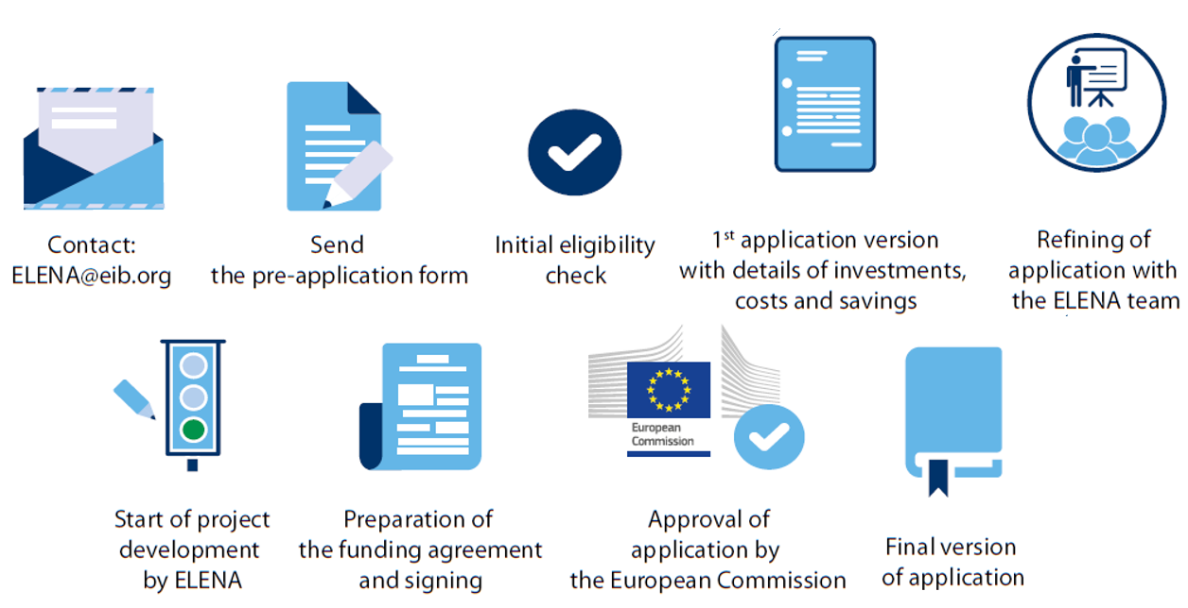
Application Process – interactive with EIB

Slide 19
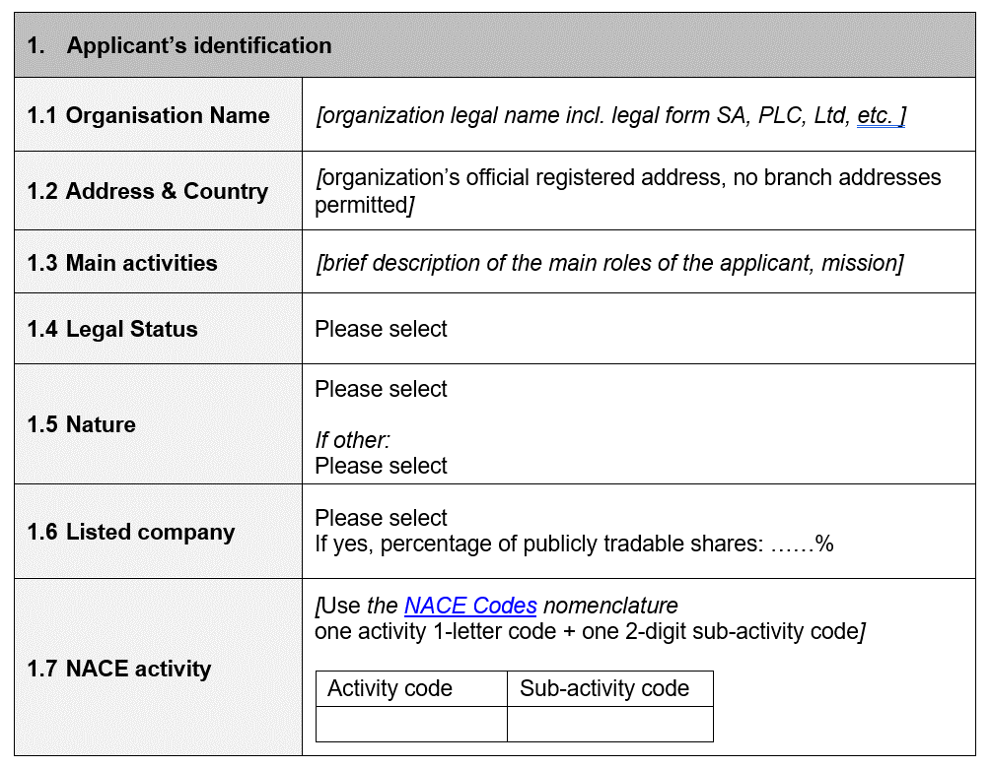
Pre-application (1)

Slide 20
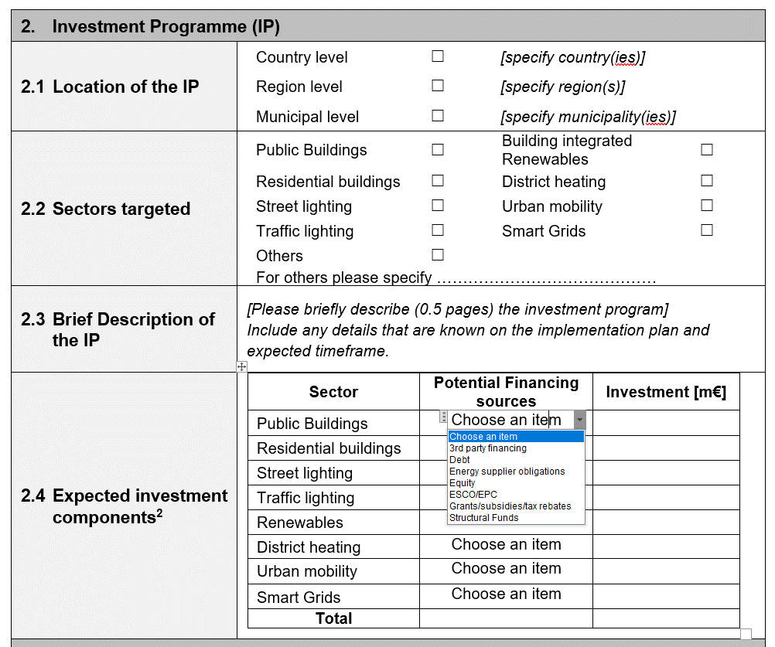
EE in buildings: 20 buildings (75,000 m2) owned by government and municipalities
EE measures include: HVAC, lighting, insulation.
35% energy efficiency achieved
RE in buildings: solar PV and solar DHW on rooftops and carparks.
Installed capacity: 100 kWp
EE in street lighting: : upgrade to LED. 5,000 lighting points to be retrofitted. 80% energy efficiency achieved.
Pre-application (2)

Slide 21
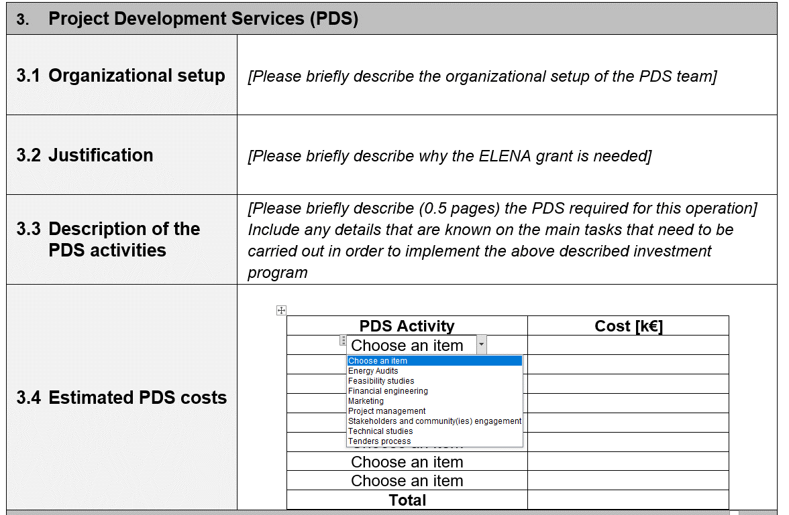
Energy Agency will manage project. Mandate from Ministry of Finance.
Agreement with National Association of Municipalities
ELENA Project Team – existing staff of Agency + 2 new hires
Consultants will be hired for extra services
One staff from each municipality will be nominated to liaise and provide data
Pre-application (3)
ELENA will help to speed up implementation
Energy Agency needs more staff to increase support to municipalities
Municipalities lack resources to put into action the Climate and Energy Plans
Shortage of skills is some areas: procurement, business planning, financial engineering
ELENA will help to absorb available funds 2021-2027
Energy audits
Solar technology studies
Financial studies
Applications for national funding (RRP)
Setting energy baselines and retrofit options
Public procurement – documentation and launch
Project management
PDS budget: EUR 1.2 million

Slide 22
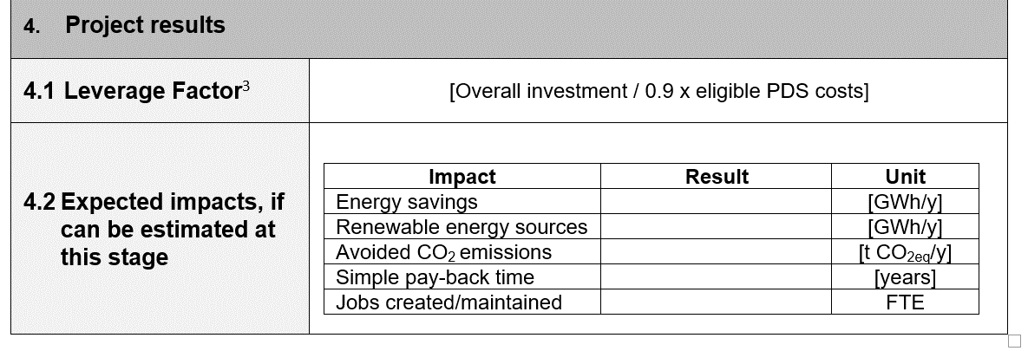
Pre-application (4)
$$\frac{Investments}{0.9×PDS costs}=\frac{36,000,000}{0.9×1,200,000}=33$$

Slide 23
When can we expect your Pre-application?
ELENA
YOU

Slide 24
THANK YOU
Assen Gasharov a.gasharov@eib.org
Dinis Rodrigues d.rodrigues@eib.org

