Slide 1
Energy-efficient maintenance and repair of building services equipment

Slide 2
Contents
Ventilation and indoor climate
Heating
Maintenance of building services equipment
Energy-efficiency repairs of building services equipment

Slide 3
Ventilation and indoor climate

Slide 4
Ventilation
Ventilation is a major consumer of energy.
Ventilation brings fresh outdoor air inside the house and removes impurities, such as:
CO2, moisture, dust, toxins, allergens, smell of food
emissions from new construction materials and furniture.
Insufficient ventilation causes:
mustiness, odours
increase in CO2 content, heacache and tiredness
condensation, moisture damage
microbial growth.
Air must be able to flow between rooms
remember gaps under thresholds, keeping the doors open…
Notes:
The air should change at least once in two hours when people are in the room.
Microbes produce toxins, for example.

Slide 5
Good indoor air
Decree of the Ministry of the Environment on the Indoor Climate and Ventilation of New Buildings (YM 1009/2017)
Room temperature may fluctuate between 20°C and 25°C during the heating season and between 20°C and 27°C outside the heating season. (Section 4)
Particulate impurities or physical, chemical or microbiological factors in quantities which could endanger health or odours continuously adversely affecting comfort shall not be present in indoor air. (Section 5)
The design value for the instantaneous concentration of carbon dioxide in indoor air during the design occupancy period of a room shall be at most 1,450 mg/m3 (800 ppm) greater than the concentration in outdoor air. (Section 5)
The outdoor air flow of the entire building shall be designed to be a minimum of 0.35 (dm3/s)/m2 of floor surface area. The outdoor air flow of a dwelling unit shall be designed to be a minimum of 18 dm3/s. (Section 9)
The outdoor air flow for a building other than a residential building shall be a minimum of 0.15 (dm³/s)/m² of floor surface area outside the design occupancy period, and the air shall be exchanged in all rooms. (Section 10)

Slide 6
Ventilation rate
Regulations regarding ventilation rates are included in the following sources:
Decree of the Ministry of the Environment on the Indoor Climate and Ventilation of New Buildings (YM 1009/2017)
Decree of the Ministry of Social Affairs and Health on Health-related Conditions of Housing and Other Residential Buildings and Qualification Requirements for Third-party Experts (STM 545/2015)
Indoor Climate Classification (RT 07-11299)
Indoor air Class S3 is up to par with the decrees; Class S1 means very good and Class S2 good indor air quality.
Example: rated outdoor air flow values for living rooms and bedrooms
Indoor air class | S1 | S2 | S3
Normal occupancy (litres per second per person) | 10 | 8 | 6
Boosted situation, apartment-specific increase possible | 30% | 30% | 30%
Basic ventilation during absence (litres per second per person) | 0.2 | 0.2 | 0.15
Notes:
Repealed old D2 regulations:
Fresh outdoor air is brought into bed and living rooms.
Bedrooms 0.5 l/s/m2
Living room 0.5 l/s/m2.
Air is removed from rooms of high moisture or impurities.
Kitchen 8–25 l/s
Bathroom 10–15 l/s
Utility room 8–15 l/s
Toilet 7–10 l/s
Sauna 2 l/s/m2
Walk-in closet, storage rooms 3 l/s.
(Cooking 25 l/s)

Slide 7
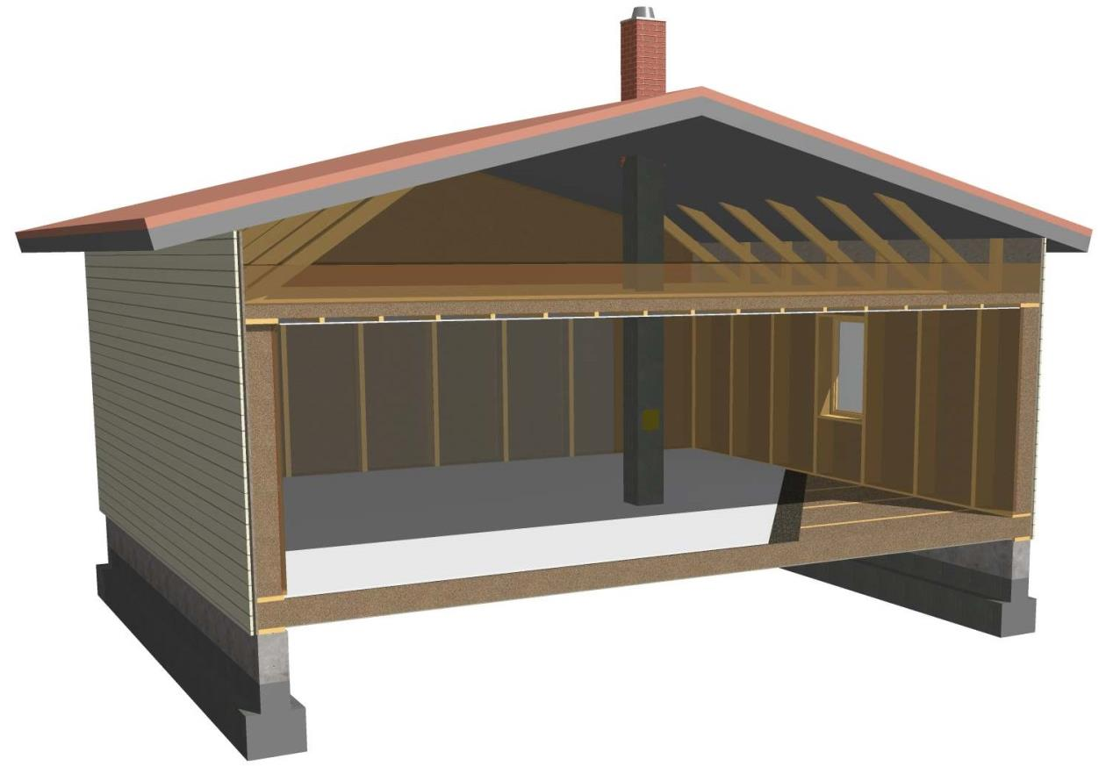
Natural ventilation
When ventilation is natural, warm air flows out
through a flue and fresh make-up air flows in through the wall vents.

Slide 8
Natural ventilation
Commonly used until the 1960s.
Natural ventilation is based on the fact that warm air is lighter than cold air and flows upwards. Due to the difference in temperature, pressure is different indoors and outdoors.
In the winter, the temperature difference between indoor and outdoor air is big, making pressure difference big, too, and ventilation works well.
During a warm season, the effect of e.g. oil-fired heating that is warming the flue will boost natural ventilation. (Usually the air flows out through a brick chimney.)
Controlled supply of make-up air must be ensured by vents.
Maintaining CO2 at guideline level usually requires constant ventilation through the windows.
Blocking the vents due to draught is a common problem.
Basic maintenance means cleaning the vents regularly.
Notes:
Make-up air must be directed to the bedrooms.
Threshold gaps are necessary particularly with natural ventilation.

Slide 9
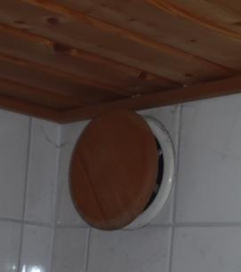
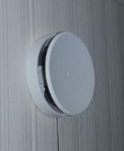
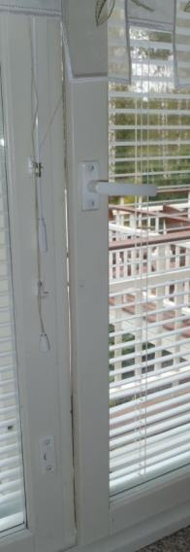
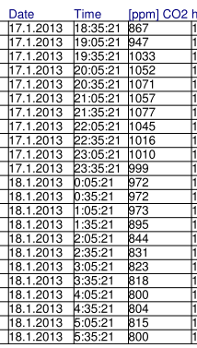
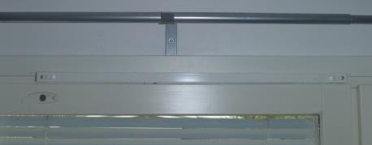
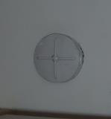
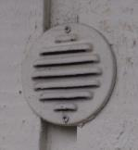
Example: Natural ventilation in a residence of 150 m²
Supply air downstairs:
3 fresh-air vents
1 ventilation window
ajar (1 cm)
Air quality:
Outdoor temperature –25ºC
On both floors 2 persons
CO2 content only on a satisfactory level upstairs.
Exhaust air:
There is 1 exhaust air vent in the washroom downstairs.
Window is ajar and there is a vent on top of the window in the upstairs bedrooms.
Notes:
The design value for the instantaneous concentration of carbon dioxide in indoor air during the design occupancy period of a room shall be at most 1,450 mg/m3 (800 ppm) greater than the concentration in outdoor air. (YmA 1009/2017 Section 5 ) This makes circa 1250 ppm because outside the CO2 content is circa 450 ppm. See slide 6
According to the Decree of the Ministry of Social Affairs and Health on Health-related Conditions of Housing and Other Residential Buildings and Qualification Requirements for Third-party Experts (STMa 545/2015), the action limit for carbon dioxide in indoor air is exceeded if the concentration is 2,100 mg/m3 (1,150 ppm) higher than the carbon dioxide concentration of outdoor air. Even smaller concentrations can cause tiredness and headache and reduce work efficiency.
A conflict or rates! The decree of the Ministry of Environment is a guideline for design and the decree of the Ministry of Social Affairs and Health is a guideline for the operating conditions.
According to indoor climate classification, good indoor air contains CO2 at most circa 1,450 mg/m3 (800 ppm) and satisfactory indoor air at most circa 1000 ppm.
(When CO2 content outdoors is circa 450 ppm.)

Slide 10
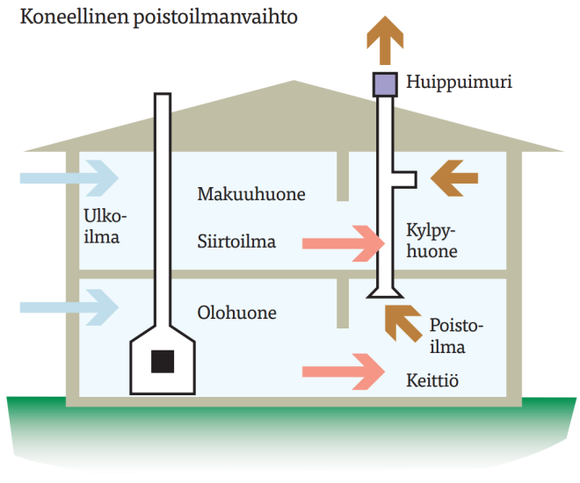
Mechanical exhaust ventilation
Common during 1960–1990.
Air is removed using fans.
Controlled usually by the cooker hood.
Requires sufficient routing for make-up and transferred air.
Blocking the vents due to draft is a common problem.
It is important to monitor the fans’ operation.
The vents need regular cleaning.
Mechanical exhaust ventilation
Suction fan
Outdoor air
Bedroom
Transferred air
Bathroom
Living room
Exhaust air
Kitchen
(Illustration: Sisäilmayhdistys, Finnish Society of Indoor Air Quality and Climate)
Notes:
Make-up air may enter through a fireplace. Frequent use of fireplaces reduces the problem.
Pressure ratio?

Slide 11
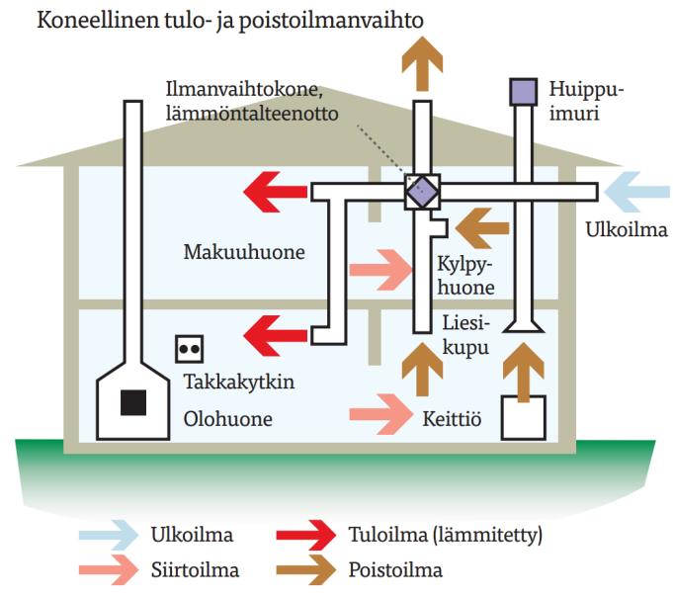
Mechanical supply and exhaust ventilation
Air is brought in and removed using fans.
The system can be accurately set, and weather does not impact the ventilation.
Supply air is filtered and pre-warmed if necessary.
The heat recovery function brings energy from exhaust air back to the building.
Buildings were previously designed to have slight underpressure. These days the objective is to reach a balance.
The building envelope must be airtight.
Too much underpressure may suck microbes into old buildings.
Mechanical supply and exhaust ventilation
Ventilation unit HRV
Suction fan
Outdoor air
Bedroom
Bathroom
Cooker hood
Fireplace switch
Living room
Kitchen
Outdoor air
Supply air
Transferred air
Exhaust air
(Illustration: Sisäilmayhdistys, Finnish Society of Indoor Air Quality and Climate)
Notes:
Decree of the Ministry of the Environment on the Indoor Climate and Ventilation of New Buildings
Section 21: Pressures caused by air flows and airtightness of structures
A special designer shall design a building’s outdoor air and exhaust air flows so that structures are not exposed to any long-term moisture loads damaging the structures due to positive pressure or any transfer of impurities to indoor air due to negative pressure. A principal designer, special designer and building designer shall, in accordance with their respective duties, design the airtightness of a building’s envelope and internal structures and its chimney effect management so that the prerequisite conditions for the functioning of ventilation can be secured, the transfer to indoor air of impurities from structures, soil impurities and radon is avoided and the transfer of moisture into structures is avoided.

Slide 12
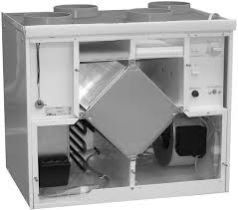
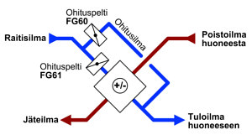
Heat recovery ventilation (HRV)
A significant portion of energy can be recovered from exhaust air by using heat exchangers.
The recovered energy is used to heat the supply air or, for example, domestic water through a pump using exhaust air.
Heat recovery requires that the building is airtight.
Modern HRV systems’ annual efficiency is circa 70%.
Example:
Bypass damper
Bypass air
–5
+22
Fresh air
Exhaust air from the room
Bypass damper
+12
Waste air
Supply air to the room
+13
(www.airwise.fi)
(www.eksergia.fi)
Notes:
New heat exchangers’ transient efficiency is usually approximately 80%. However, in the winter, for example, defrosting the heat recovery cell reduces annual efficiency.

Slide 13
Heating

Slide 14
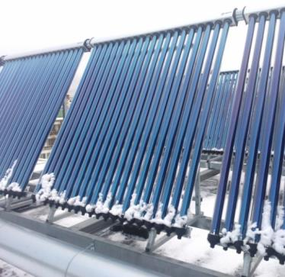
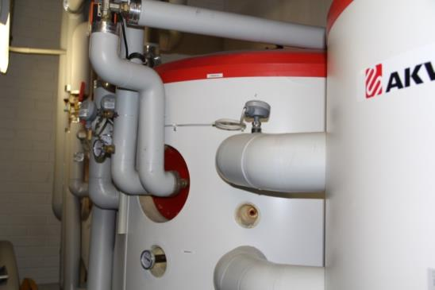
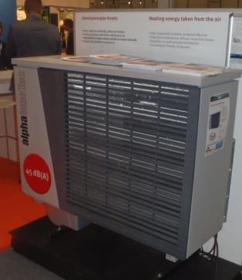
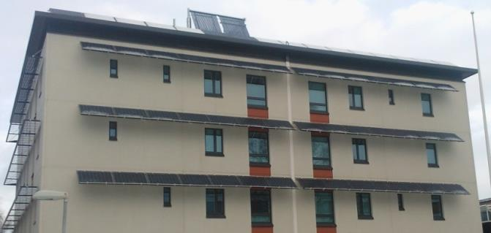
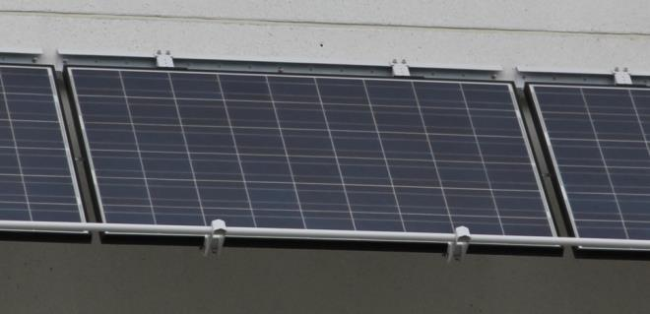
Heating systems Renewable forms of energy and hybrid systems are gaining ground
Notes:
Solar panels are placed over facade windows. On a cloudy day, energy output was 386 W.

Slide 15
Heat pumps
Up to 2019, about 700,000 air-source heat pumps were installed in Finland, and they produce 7 TWh of energy per year.
There are about 160,000 oil-fired boilers and about 450,000 direct electric heating systems in use in residential buildings. Heat pumps are very suitable to complement or replace them.
There are nearly 50,000 exhaust air systems in apartment houses.
A pump using exhaust air is a good way to save their energy. At best, heating costs can be reduced by 40–50%.
The energy company cannot increase the price of energy because of a housing company investing in a heat pump.
Heat pump compressors are robust, but errors in installation, settings, or use may eliminate the benefit of using a heat pump.
Users need clear printed instructions and individual training.
Notes:
Circa 50,000 air-source heat pumps are installed every year.
Circa 8,000–10,000 geothermal heat pumps are installed every year.
http://www.stat.fi/tietotrendit/artikkelit/2018/uusiutuva-energia-valtaa-alaa-pientalojen-lammityksessa/
https://www.sulpu.fi/documents/184029/0/La%CC%88mpo%CC%88pumpputilasto%202018%2C%20%20kuvaajat%20FI%2C%20f.pdf

Slide 16
Pump properties
The coefficient of performance (COP) of the air-source heat pump indicates how efficiently the consumed electrical energy is transformed into thermal energy.
The COP is always measured at +7 Celsius degrees. For example, value 4 means that one kW from the power network produced 4 kW of heating capacity.
Seasonal coefficient SCOP is calculated for (4 different) heating periods.
In additoin, Europe has been divided into 3 different climate zones. The northernmost zone is based on the weather in Helsinki. However, this value is often not presented in the pump brochure.
EER refers to energy efficiency ratio. A good value for EER is more than 3.5.
SEER refers to seasonal energy efficiency ratio, which is usually not an important benchmark in Finland.
According to a Swedish study, geothermal pumps’ SCOP values in the 2010s were 3.5–5 in floor-heated houses and 3.0–4.1 in radiator-heated houses.
In the south of Sweden, the SCOP values of air-water heat pumps were 1.8–3.0 and the SCOP values of air-source heat pumps were 2.8–3.4 for radiator-heated houses (mean temperature 6.1ºC).
In the north of Sweden, the SCOP values of air-source heat pumps were 1.7–2.6 (mean temperature +1.3ºC).
Notes:
http://www.energimyndigheten.se/tester/jamforelsesida/?productTypeVersionId=334&comparisonProducts=1391,1392,1281,1280,1279,1278,1277,1276,1272,1337,1273,1274,1275,1271,1270,1268,1269,1267,1266

Slide 17
Comparison and selection of heat pumps
Heat pumps are very suitable to use as the main heating system in new construction and as an additional source of heat in old buildings.
Consider the following when selecting a heat pump:
SCOP, climate, and purchase price.
Existing heat distribution method; old single-panel radiators do not provide the best efficiency with air-water and geothermal pumps.
A lower temperature on floor heating increases the pump’s efficiency.
Air-source heat pumps can be used to clean indoor air flexibly and quickly. However, indoor units require regular cleaning.
Combined with floor heating, air-water and geothermal pumps are easy and pleasant to use.
Notes:
In a house heated by radiators, it is a good idea to control ground heat based on monitoring the outside temperature and by adjusting the temperature of supply water. Radiator thermostats are set to maximum power. By this kind of control the water temperature of the radiator system can be kept as low as possible. The backwater pump should be renewed when installing geothermal heating. It is a good idea to over-dimension the pump to ensure sufficient water circulation for the system. The price difference to a more powerful pump is minimal.
Coefficients of performance (COP, SCOP)
The coefficient of performance (COP) of the air-source heat pump indicates how efficiently the consumed electrical energy is transformed into thermal energy. COP is always measured at +7 Celsius degrees. This value alone does not indicate how well the system actually works in minus degrees in the winter. For example, COP of 3 means that 1kW input power produces 3 kW heating capacity.
Modern air-source heat pumps have COP values of 4.5–5.5.
The Seasonal Coefficient of Performance (SCOP) indicates the value for the heating period. A separate SCOP value is calculated for each specified heating period (4 different outdoor temperatures) because the applicable temperature ranges, nominal temperatures, and nominal loads vary according to the period. In additoin, Europe has been divided into three different climate zones. Southern Europe’s calculations are based on the climate of Athens, Central Europe’s calculations on the climate of Strasbourg, and Northern Europe’s calculations on the climate of Helsinki.
Thr new energy label shows the energy classifications for each climate area. The same air-source heat pump may have three different energy classes depending on the climate zone of the installation.
Air-source heat pumps’ SCOP values are roughly 3.5–5.

Slide 18
Hybrid systems
Hybrid refers to using several heating systems together. Heat pumps are often used together with other systems.
In hybrid systems, energy is first taken from heat pumps, and when their capacity ends, from other sources.
Usually slight under-dimensioning i.e. partial efficiency brings the most economical result. A fireplace or electrical heating is used to help during very low freezing temperatures. This reduces the depth of the bore well for the geothermal heat pump, for example.
Dimensioning alternatives should be compared when acquiring the system and ensure that bids are compatible regarding dimensions.
The internal unit of the air-source heat pump is installed into as large and accessible space as possible.
Other heaters must be set to lower temperature in its area of influence.
The room where the pump is located is kept at higher temperature compared to other rooms. Warm air is then transmitted to other rooms.
It is very difficult to optimize three heating sources used together.
The settings must be testesd during both a cold and a warm season.
Notes:
Consider the following when locating an air-source heating unit:
In multistorey buildings, heating and cooling are directed differently. Warm air moves up and cool air flows down. The heating aspect is more decisive.
The vibration of an outdoor unit may produce frame noise inside; installation on a concrete foundation or platform.
Partial power dimensioning may lose benefits if, in the future, electricity pricing is to consider peak loads more.
This is something to consider when calculating the viability of air-water heat pumps in particular.

Slide 19
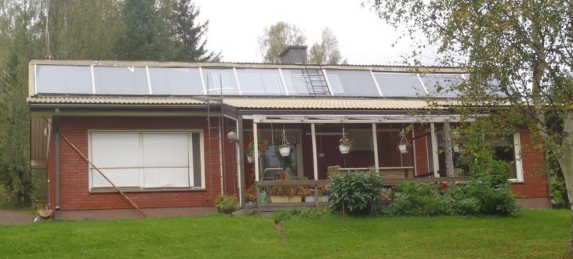
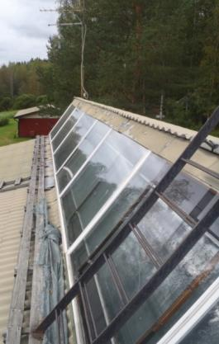
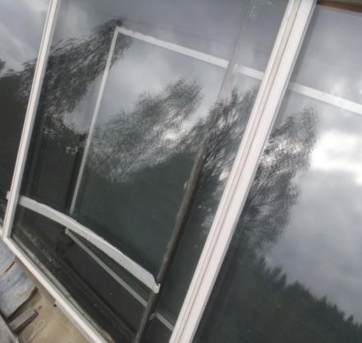
Solar heating since 1985
Pay attention to major temperature variation in solar collectors
Thermal motion in the fastening, seams, and penetrations.
Thermal motion in pipes.
Liquid boiling and evaporating.
Danger of overheating and fire.
Insulation and sealing.

Slide 20
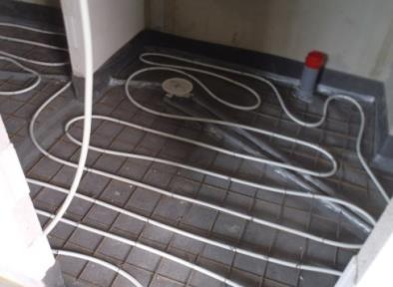
Heat distribution
Regarding heat distribution pre-settings, consider that corner rooms and lower floors require more heating. Moreover, thermal loads, including solar radiation and delays due to structures’ reserve capacity, must be taken into consideration.
In low-evergy buildings, the variation of internal thermal loads affects thermal needs greatly and quickly. Variation in outdoor temperature has low and slow impact.
Radiation is easy to adjust but requires relatively high temperature for the heating water.
Floor heating provides plenty of heating capacity and a sensation of warmth with low temperatures, but slow control may cause overheating.
It is important to insulate heat pipes and warm backwater pipes because of both heat loss and the thermal loads caused by it.
Also consider temperature, comfort, air flows, draught sensation.
Heating can be set to lower power by removing draught and “cold radiation”.
Lowering the temperature by 1 degrees reduces the need of heating energy by circa 5%.

Slide 21
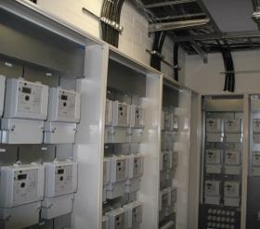
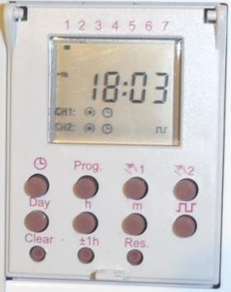
Need-based use of electricity
Choose electrical devices and systems that can be controlled based on the need
The blowing power and temperature of air-source heat pumps and ventilation units can be reduced when leaving the space.
Temperature can be lower during the night, too.
In addition to the thermostat, floor heating can be controlled by a time switch to be dead or periodic when there is less need for heating.
Washing laundry and dishes can be timed for the night when electricity consumption is low. It reduces the costs of the energy company and may impact the pricing of electricity.
These days consumers, too, can purchase electricity per hour.
Cars can be heated by the hour or per outdoor temperature, and electrical cars charged during the cheap power hours.
Public spaces and outdoor lights can be controlled using time switches and motion sensors. Baseline values are set to save energy but taking into account the need of lighting.
Electrical sauna stoves and back boilers can be heated alternatively to room heating by using an electricity control system.
Choose devices that have classification A+++.
Notes:
Photo 1. Photo of a near zero-energy house’s power room in Kuopas. The student dormitory has electricity metering per apartment.
Photos 2 and 3. Two-channel time control in a family home’s power room. The timer controls floor heating in the kitchen and yard lights.

Slide 22
Maintenance of building services equipment

Slide 23
Signs of poor ventilation
Indoor air feels musty coming into the house.
Windows and mirrors stay foggy for a long time in wet rooms.
Vents are missing, closed or blocked.
Underpressure can be heard make a “whoosh” when opening a door or a window.
A sheet of paper does not stick to the exhaust vent.
With air heating, the danger is that the great need of ventilation causes a sense of draught.
Silence → Ventilation is off.
Ventilation unit makes noise → Dimensioned too small.
Notes:
A person gets used to bad indoor air in half a minute.

Slide 24
Maintenance of a ventilation unit
The filters of the ventilation unit must be cleaned or replaced at least twice a year.
Always clean after the pollen season. The filters can be cleaned by vacuuming and/or compressed air, for example.
The filters are to be replaced when dirt reduces the air flow. Reduced air flow increases pressure loss and the fans’ energy consumption, weakens HRV efficiency, and reduces the quality of indoor air.
The heat recovery cell or wheel is removed and washed in water every 2 to 3 years. A bit of dishwashing liquid can be added to the water.
For more detailed maintenance instructions, see manufacturer’s use and maintenance manuals. Any ventilaiton unit must always be switched off dead during maintenance work.

Slide 25
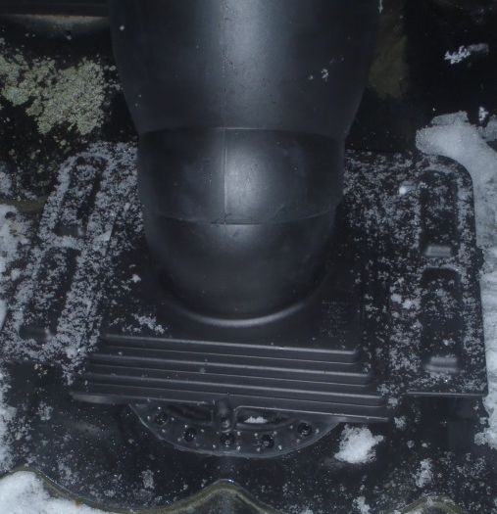
Maintenance of vents and ducts
Textile dust accrued in the air gap of a vent is to be vacuumed yearly. Wet room exhaust vents in particular require cleaning.
If necessary, the vent can be removed and cleaned more thoroughly. The vent settings are not to be changed so that the pressure ratio of the room does not change.
Ventilation ducts must be swept at least every 10 years.
The condition and airtightness of roof penetrations must be inspected yearly.

Slide 26
Monitoring of energy consumption
Correct system operation is to be ensured during maintenance.
Has energy consumption been normal?
Are the temperature and air humidity on appropriate levels?
Are the users of the room happy?
Has there been any need for additional ventilation? Have windows been kept open?
Contact energy sales and companies for more information, including:
Energy consumption of the location.
Comparisons to same type of buildings.
Alarms to email abut increased consumption.
Repairs and system changes’ impact on consumption.

Slide 27
Energy-efficiency repairs of building services equipment

Slide 28
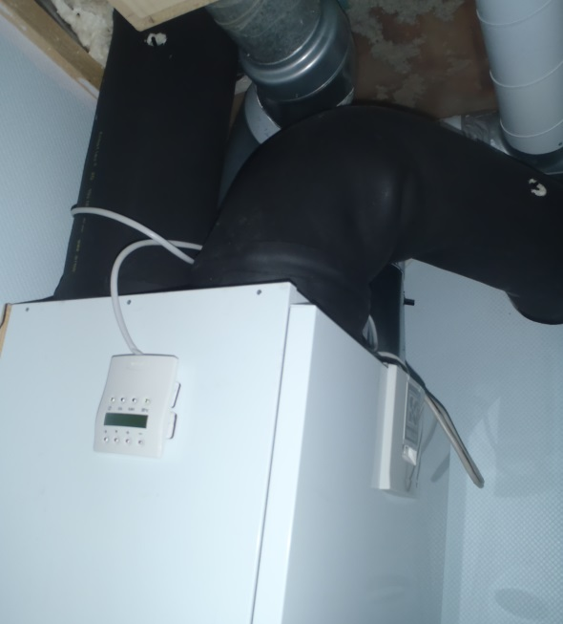
Energy-efficiency repairs of building services equipment
The impulse to improve energy efficiency usually comes from another repair objective, such as:
The end of service life, breakage, or high cost of maintenance of a building unit or system.
Comfort, sensation of draught, or removal of cold radiation.
Improvement of indoor air quality.
Maintaining the property’s value.
Update of systems and equipment to meet modern requirements.
When it’s time to renovate, consider the opportunities to save energy at the same time.
Notes:
Adding control to automation
Replacing fans
Lighting renovation

Slide 29
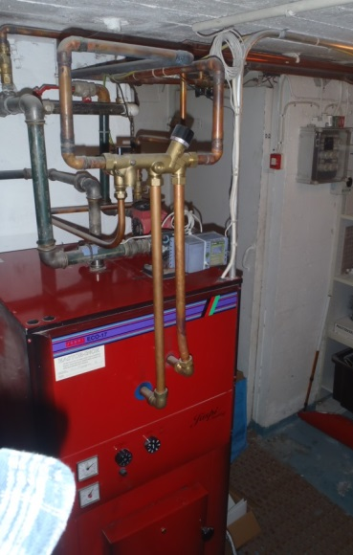
…and vice versa. Review building services’ energy efficiency repairs’ impact on the structures and uses of the building.
When heating based on combustion is replaced by e.g. a geothermal system:
Natural ventilation efficiency is reduced.
Users need to change their behaviour.
More ventilation is needed.
Changes to the laundry-drying method.
Drying the washroom floors.
“Boiler room” temperature goes down.
Adding a radiator.
Adding thermal insulation.
Changing the heating system requires reviewing many other aspects, too.
Notes:
Fuse size of electrical interface when oil is replaced by a geothermal system.

Slide 30
The energy efficiency of building services is influenced by:
Device choices, systems and their compatibility.
Duct and pipe routes and insulations.
Airtightness of ducts, penetrations and rooms.
Purity of grids, filters and valves.
System settings and control automation.
Use and maintenance.

Slide 31
Choices related to heating systems can improve energy efficiency
Installing mechanical and heat recovery ventilation.
Improvement of heating system efficiency.
Replacing main method of heating to one based on renewable energy.
Complementing the main method of heating:
with heat pumps
solar collectors or panels
heat-storing fireplaces or ovens…

Slide 32
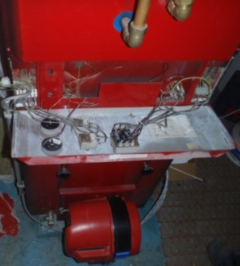
Improvement of heating distribution system’s energy efficiency
Replacing pumps, fans and devices with more energy-efficient versions.
Adding time switches and load management to heating and ventilation control.
Installing, renewing or re-setting thermostatic radiator valves and other control equipment.
Adding or repairing thermal insulation on heat pipes, warm white water system and ventilation ducts.
Notes:
Hiring a designer and not copying old designs. Diligent overall design.
Copying building automation often produces errors.

Slide 33
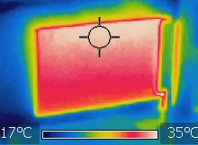
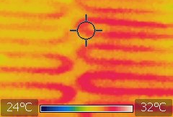
The impact of heat distribution method on the use of energy
It is important that a room feels warm.
When the reasons to feeling cold are removed, temperature can be reduced.
Temperature reduction by 1 degree will save circa 5% in heating energy consumption.
Radiators under the windows reduce:
cooling air on the window surface,
downward flow and the sensation of draught,
“cold radiation”.
Floor heating adds comfort but may be difficult to control (sensor location, heat-storing capacity, and delay in changing temperature).
Ceiling heating is comfortable but warmth may not always reach under the tables.

Slide 34
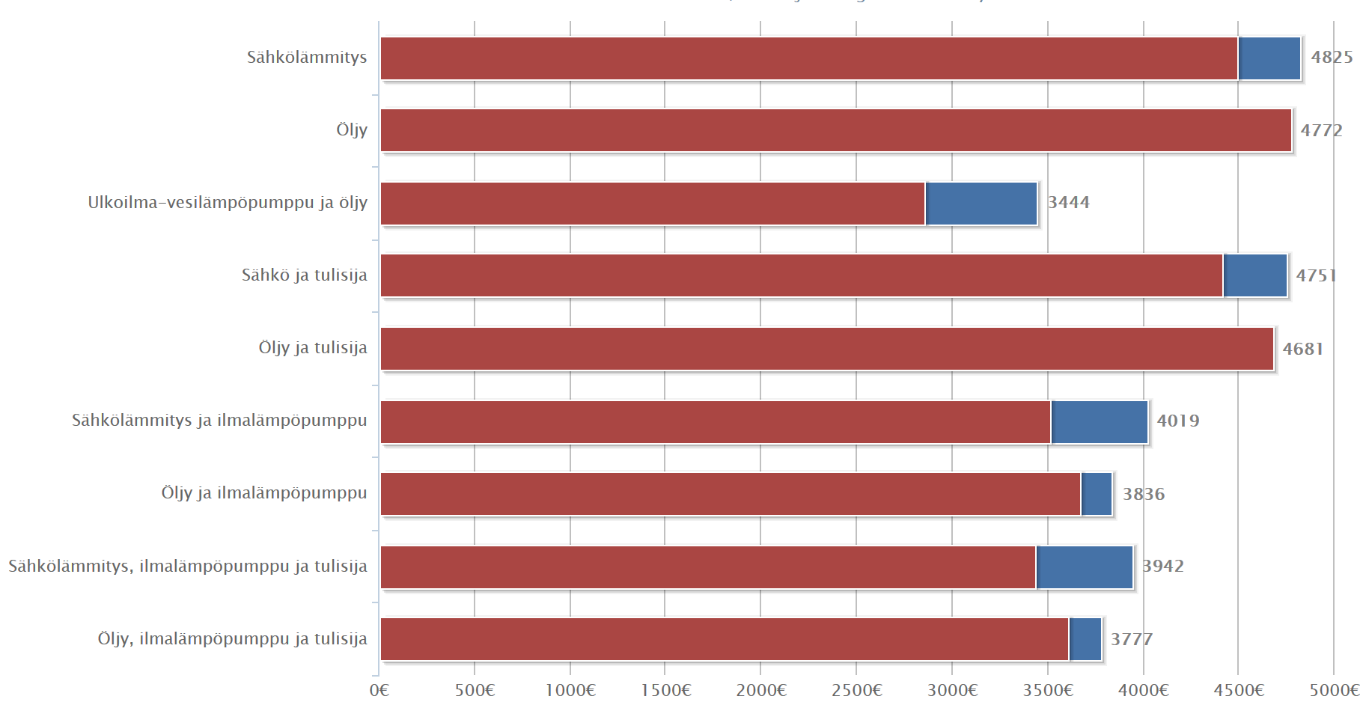
Calculating heating system costs
Electrical heating
Oil
Outdoor water heat pump and oil
Electrical and fireplace
Purchase prices
Amount and price of delivered energy
Constant basic fees
Price development in the future
Reference rate
Maintenance and repair costs
Oil and fireplace
Electrical heating and air-source heat pump
Oil and air-source heat pump
Electrical, air-source heat pump and fireplace
Oil, air-source heat pump and fireplace
www.lammitysvertailu.eneuvonta.fi

Slide 35
Exercises
How much energy is consumed in your house yearly?
How much of it is used for heating?
What is the average energy consumption of various electrical devices per day and year?
Which measures can be taken to reduce the energy bill?

Slide 36
Example: A 100 m² house in Tampere built in 1990 (according to 1985–2003 standard)
Yearly consumption
Volume 250 m³ → Ventilation 125 m³/h (0.5 times/h)
Ventilation consumes ca. 9,000 kWh without heat recovery.
Energy transfer through the building envelope ca. 15,000 kWh
One resident uses ca. 1,000 kWh to heat domestic water.
Family of four uses energy ca. 28,000 kWh in total.
Settings and user behaviour determine the eventual savings.
Examples of saving measures for heating
Geothermal pump savings 18,000–21,000 kWh (excl. HRV)
Air-source heat pump savings 3,000–6,000 kWh
HRV saving potential ca. 70% of ventilation i.e. 6,300 kWh
Geothermal+HRV savings ca. 20,000–22,000 kWh
Air-source+HRV savings ca. 10,000–12,000 kWh
Annual efficiency calculated Geothermal 3–4 and air-spurce pump 2–2.5
Domestic electricity use of 4,000–5,000 kWh was not taken into account.
Notes:
Domestic appliances, such as electronics, computers and lighting, use ca. 4,300 kWh.
Some of this can be utilized for heating.

Slide 37
To consider when selecting energy efficiency repair methods
Water-filled radiators combined with heat pumps and water-based heating distribution do not achieve as high efficiency as floor heating.
Two-panel radiators are a better match than one-panel radiators to be used with heat pumps.
When using an air-source heat pump, it is easy to reduce room temperature during absence. (Not taken into account in previous slide’s example).
In a garage or recreational facility, the temperature can be quickly risen for temporary use of the room with an air-source heat pump.
The amount of energy gained from a pump using exhaust air is relatively small. It does not usually suffice as the main heating system in repair construction.
Energy savings from installing mechanical and heat recovery ventilation may be scarce because air volumes usually increase at the same time and fans, too, consume energy.
Airtightness of structures and system settings impact the efficiency ratio.
Notes:
In practice, the difference in efficiency between floor heating and water-filled radiators is not highly significant. The difference is significant only during very low outdoor temperatures which mostly occur only during 1–3 weeks per year.

Slide 38
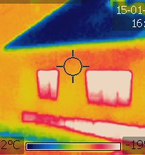
Total system management?
The building’s windows and and balcony doors were replaced
The airtightness of the building envelope improved and the quality of indoor air was reduced.
Exhaust ventilation was set more effective, and in addition, windows need to be kept open.
There was a sensation of draught.
There was a need to increase heating.
More energy was lost to exhaust air.
The window renovation increased the energy consumption of the building that only had exhaust ventilation.
A better alternative: mechanical supply-exhaust ventilation with efficient heat recovery.

Slide 39
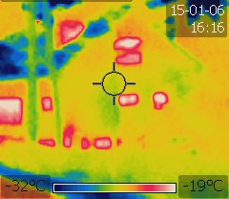
Note!
Always survey energy-saving opportunities when repairing a building.
Airtight structures, duct and pipe connections, and penetrations, and well-insulated installations are the cornerstone of energy efficient building services engineering. In connection with repairs, diligent work regarding insulation, airtightness and penetrations will bring energy savings.
The impact of individual repairs to the operation of other structures and systems must be extensively explored.
Moisture damages in building structures are often the result of poorly planned and designed renovations.
It is a challenge to design and set hybrid systems. Testing is of utmost importance.
It is important to monitor system operation, including:
air quality, heat and moisture
potentially CO2, air contents, air flow…
energy consumption
maintenance tasks, such as cleaning the ventilation filters.
Users’ behaviour greatly affects energy consumption, and users must be trained and advised to use the systems.
There are several ways to reduce energy consumption while potentially increasing living and thermal comfort.

Slide 40
This learning material contains good practices and principles for energy-efficient construction. The authors do not guarantee that the methods apply to any particular project as such. Any individual project must comply with its specific plans and designs. The original material was produced for EU’s Horizon2020 programme, the BUILD UP Skills project (Motiva Oy, TTS, TUT, 2016). Learning material team: Olli Teriö, Jukka Lahdensivu, Juhani Heljo, Jaakko Sorri, Ulrika Uotila, Aki Peltola, Jari Hämäläinen & Heidi Sumkin. This material has been updated in 2019 (Olli Teriö). www.motiva.fi/buildupskills
Thank you!

