Slide 1
Quality assurance in sustainable construction

Slide 2
Contents
Introduction
Induction and studying
QA methods
Check lists
Project parties’ responsibilities and obligations
Conclusive discussion

Slide 3
Discussion
© Heidi Sumkin
How to ensure sustainable, energy- and material-efficient and moisture-safe construction?
Use sustainable materials and fittings.
Plan work sequencing in advance.
Install moisture barriers, thermal insulation, and wind breaks airtight.
Do not ignore and hide careless work of others.
Keep thermal insulants and other materials dry.
Ensure that moisture during construction dries out.
Everybody must do their best to achieve overall airtightness and quality.
Take pride in the quality of your work!
Notes:
Practical examples:
When laying a brick wall, ensure that mortar does not block the ventilation gap behind the bricks and that every third seam is open on the two lowest rows of bricks.
Any construction panel that may have gotten wet is replaced.
Windbreak wool sheets are installed tightly and overlapped in layers.
Flashings are inclined and seams mudded up carefully so that horizontal rain cannot enter the structures.

Slide 4
Induction and studying

Slide 5
Studying the site and the project
Management organizes induction to the site.
Workers study the project.
drawings
work specifications
task plans
inspections and quality assurance measures.
Workers must also learn about new work methods and construction materials.

Slide 6
Brainstorming / pair chat / discussion
How to address quality before starting to work on a project?
For example:
Prepare and study the site.
Plan work sequencing.
Inspect the plans.
Survey the risks.
Study the plans and drawings.
Notes:
Next slides provide some answers.

Slide 7
Work preparations
Study the plans/drawings.
Take care of weather protection and dust control.
Negotiate scaffolding and special tools.
Plan weekly and daily routines.
Pay attention to materials’ drying times.
Learn the quality requirements.
Only accept completely finalized previous project phase and a clean site.
© Heidi Sumkin

Slide 8
Work sequences and schedules
Several work sequences usually take place on site at the same time.
They may clash and cross each other.
Wait until the previous work phase has been completed and the structures are dry enough before starting your project.
Finish your share of the work at one go and hand over the site to the next contractor completed and cleaned.
Construction is all about teamwork. When everyone involved plays their part, the project is easier for all.

Slide 9
Studying the plans/drawings
Read the work specifications for your share of the project.
Study the drawings.
Ask supervisor to provide more instructions if necessary.
The common quality requirements for construction
RT standards etc.
manufacturer’s installation instructions.
Ask the supervisor about special requirements.
Demand drawings for connections and corners.
Inform the supervisor about conflicts in the plans.
Pay attention to other contractors’ projects.

Slide 10
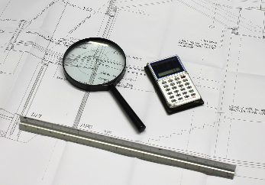
Studying the plans/drawings
Check the plans and drawings for
faults and “loop holes”
inclusion of the most complicated details
measurements
risk factors
conflicts in and between the plans
conflicts between the plans and work specifications.
Report conflicts, faults and errors to the supervisor.
Notes:
Ceiling drawings
Building services and electrical installations in meeting/class rooms, corridors...

Slide 11
Identifying risk factors
The structures should last for decades; remember this during installation.
Learn the quality requirements.
Estimate moisture resistance, condensation, and health risks.
All that seems difficult to build will include risk factors. Discuss them with colleagues and supoervisors.
Evaluate the most critical aspects regarding the next phases.
It’s better to be safe early than very sorry later.
Note! A plan/drawing can include faults.
Notes:
Do not work on an unacceptable base from a previous phase that may ruin the quality of your work.

Slide 12
Brainstorming / pair chat / discussion
Which of the following will impact the quality of your work the most?
Your skills
plan/design/drawing quality
tools and materials.

Slide 13
QA methods

Slide 14
Brainstorming / pair chat / discussion
How to ensure the quality of your work?
For example:
sample installations
checking for conspicuous problems
measuring
handover testing
next contractor’s commissioning inspection.

Slide 15
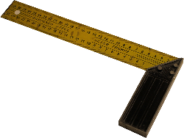
QA methods
Humidity metering
Thermal imaging
Videoshooting of drains and ducts
Airtightness metering
Tracer testing and smoke tracing in renovation projects
Check lists
Journals
Metering minutes
Water block samples

Slide 16
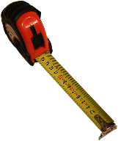
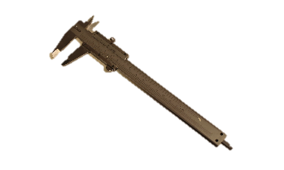
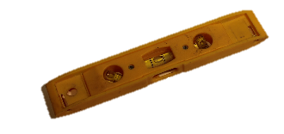
Learning by measuring
Study the requirements in advance and measure how they are met during the work and after completion.
Dimensions, cross calipering
Evenness
Straightness vertically and horizontally
Airtightness, tracer testing
Film thickness.
Notes:
Include installation workers in the measuring
Requirements: plans/designs, contracts, RYL, RT standard...

Slide 17
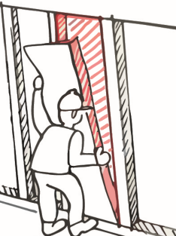
Sample installations
It is recommended to do sample installations of the most critical tasks.
It will help survey the risk factors and understand the engineering.
To agree upon when providing the sample:
What is the baseline, incl. platform and site.
What are the quality requirements for the work, including straightness, evenness or airtightness and durability.
What is the desired end result.
One option is to build a sample room, which will also help coordinate the design disciplines.
© Heidi Sumkin
Notes:
It is highly recommendable to provide sample installations when working with indoor air renovation.

Slide 18
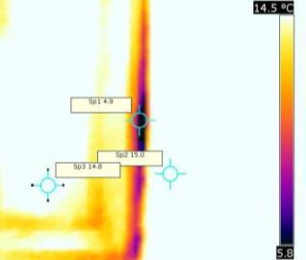
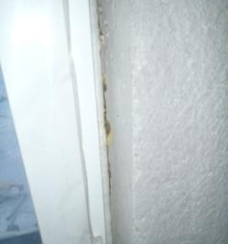
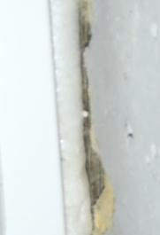
Thermal imaging for an airtight building envelope
During the cold season, it is easy to check the building envelope’s airtightness by thermal imaging.
In the summer, the method is smoke tracing.
Thermal imaging helps prevent leaks that may appear at airtightness testing, and other quality problems.

Slide 19
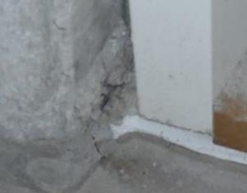
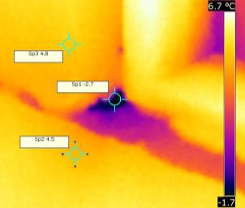
Thermal imaging for an airtight building envelope
Consider the following factors critical to airtightness:
Sealing of the uppermost vault.
Joining the floor and the foundation.
Joining the flat roof and exterior wall.
Joining floors and exterior walls.
Joining washrooms and steam rooms.
Openings for windows and doors.
Penetrations for building services.
Smoke flue units.
Joining vapour barriers.
See Hanna Aho and Minna Korpi (Eds.): Ilmanpitävien rakenteiden ja liitosten toteutus asuinrakennuksissa. Tampere University of Technology 2009.

Slide 20
Brainstorming / pair chat / discussion
Which are the most critical quality defects in construction and how to prevent them?
For example:
Moisture risks, water vapour condensation in structures
Incompatible construction materials (VOC).
Water, humidity and air leaks.
Prevention:
Study installation manual and plans/drawings.
Build it tight and ventilated, according to design.
Use common sense but do not deviate from the plans.
If necessary, discuss and agree upon changes with the designer.
Quality assurance is more than inspections.

Slide 21
Check lists

Slide 22
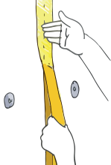
Check list: Installing windbreaks and cladding
The windbreak seams are adjusted at frame structures.
The sheets are installed tightly against the frame.
Ensure long-term durability of the seams with exterior battens if necessary.
The windbreak must include effective thermal insulation so that a timber frame stays warm and dry.
Do not use windbreak foil alone.
Leave a gap for ventilation behind cladding all the way to the top.
Leave ventilation routes under and over the windows.
Rainwater is steered away from the wall structures by rain gutters and pipes, as well as with window, threshold and storm flashings and other cover strips and drips.
The corners and connection details must be designed diligently to stand the test of time.
© Heidi Sumkin

Slide 23
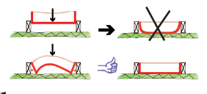
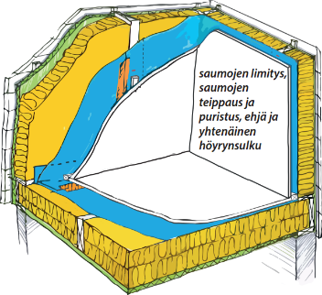
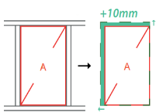
Check list Installing soft thermal insulation
The insulant is to fill the insulation space completely.
The insulant is pressed against both the structures and other insulation.
Insulation under floors and ducts, in particular, must be pressed against the surfaces.
On the right: Overlapping and taping the seams and compression; solid and consistent vapour barrier.
Illustrations: Heidi Sumkin

Slide 24
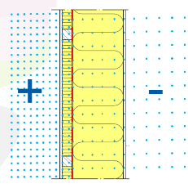
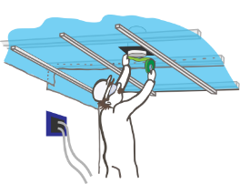
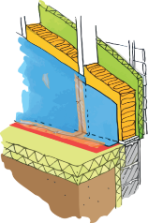
Check list Installing vapour barriers
Vapour barrier foils are overlapped at 150 mm at minimum.
The airtightness of the overlap is ensured with vapour barrier tape or by screwing a compression strip on top of the overlap against the frame.
The vapour barrier plastic is not to hang on the riveting alone. Tenacity is ensured by strips, wall framing, or taping the riveting.
At structural connection points, the foils are left with some room to move (US-US, US-YP, US-AP, VP-US).
Before paneling, any small holes are closed with vapour barrier tape.
Illustrations: Heidi Sumkin

Slide 25
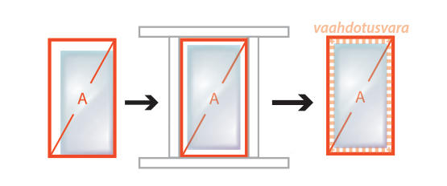
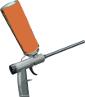
Check list Installing plastic thermal insulation
Space for foaming
Sheet pile joints are sealed by foaming and installed pressed together.
The width of the seams against the structures is 10–25 mm.
The base under the seams must be dry and clean.
The sawn borders of the insulant are cleaned with compression air, for example.
The deep seams are foamed in 2 phases.
Use a foam gun and elastic sealant foam for the seams.
Do not use the last drops of the foam container but replace it after the last “whiz”.
Illustrations: Heidi Sumkin

Slide 26
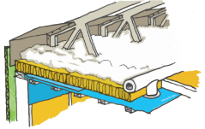
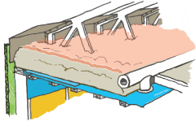
Check list Insulating with blown wool
Note that the insulant will sink on the flat roof, particularly under the diagonals and ducts.
A cavity may develop under the diagonals that may become an ice trap. The installations must be inspected after about a year.
The sheet-like mineral wool insulant between the beams will reduce sinking.
The ventilation gap in the facade and roof must not be blocked by blowing wool. The wind deflectors are to be checked before blowing.
The base under the wool must not be too flexible. Regarding the plastic film, the maximum wall framing gap is 300 mm. A hardboard of 3 mm can also be used between the pastic and the framing.
On exterior walls, the undersides of penetrations, supports and electrical outlets must be carefully filled by blowing wool.
Illustrations: Heidi Sumkin

Slide 27
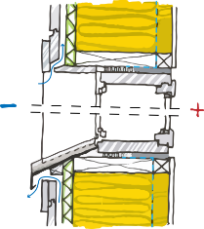
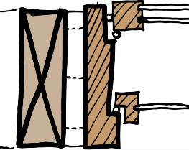
Check list Installing windows
In concrete-framed buildings, the laitance is sanded off from opposite the frame and the surface is vacuumed.
Ensure airtightness of the vapour barrier by folding the barrier between the window frame and the polyurethane foam.
Pay attention to the ventilation gap under and above the window when installing the flashing and strips.
The seam must become more airtight towards the inner surface.
There are many ways to do the sealing.
The vapour barrier can be taped on the window frame with vapour barrier tape.
Illustrations: Heidi Sumkin
Mineral wool
SPU foaming
Elastic sealing

Slide 28
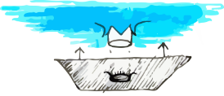
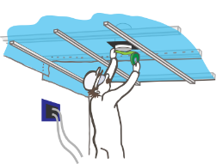
Check list Installing penetrations
The recommended choice is to use manufactured collar products.
The collars are fixed to the vapour barriers using vapour barrier tape.
The installation is to include room for the structures’ thermal and moisture movement as well as bending due to load variation.
With plastic insulation, the penetrations are sealed with polyurethane foaming.
Condensation is a risk to take into account with ducts and pipes. They must be sealed absolutely tight.
With penetrations, ensure long-term durability of the sealing.
Illustrations: Heidi Sumkin

Slide 29
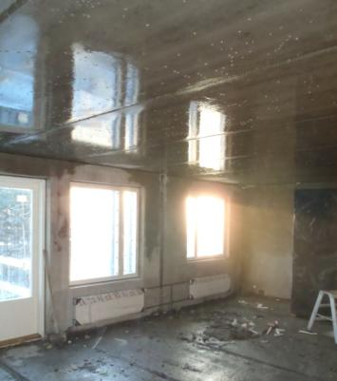
Check list Humidity in the structures and site conditions
Note!
The structures must be sealed on the inside and ventilated on the outside of the windbreak.
Ventilation is more effective if the facade is sealed after the first heating season.
Ventilation gaps and holes must be checked on the structural members, and quality must be demanded from the fabricators.
Heating and indoor-air relative humidity of circa 50% will boost drying.
Moisture must always be measured in concrete structures and sufficient drying ensured before coating.
The quality will need to last for decades so it’s better not to do the work in haste.
Notes:
29

Slide 30
Project parties’ responsibilities and obligations

Slide 31
Brainstorming / pair chat / discussion What are the project parties’ obligations and responsibilities in quality construction?
Whose responsibility is which area of the project?
Plans/drawings and instructions
Materials and structural members
Contractors and workers
Equipment and tools
Project/site
Previous work phases
Physical conditions
Sustainable construction
Notes:
Image: Last Planner list

Slide 32
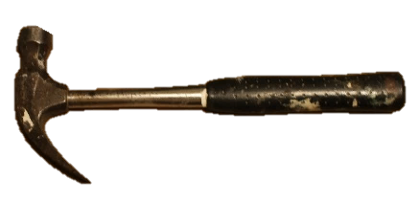
Sustainable construction playground Project parties’ responsibilities and obligations in brief
Client/project manager delivers or approves the plans/drawings and creates the schedule.
Designers depict a high quality result that fulfills the regulatory requirements.
Main contractor manages the construction site and is responsible for the site services, including passageways, large scaffolding, and general lighting, organizing a setting for quality work.
Supervisor ensures compliance with contracts and designs.
Subcontractors are responsible for their work quality.
Workers must perform their tasks according to the plans/drawings.
Notes:
In addition, workers correct the mistakes left by others ;-)

Slide 33
Workers’ responsibilities
Execute structures and details as planned and designed.
Ensure that construction materials are protected from rain and humidity.
Use only appropriate and dry materials and products.
Choose appropriate tools and work methods.
Keep the site clean and ensure weather protection and proper installation temperature and humidity.
Report poor workmanship to the supervisor, do not hide it.
Hand over the site to the next worker completed and clean.
© Heidi Sumkin

Slide 34
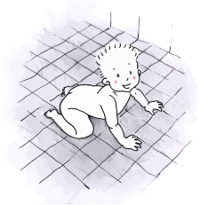
Professional pride
While surveying for competency needs,, the following skills have come up:
communication skills and cooperation between clients, designers and contractors
problem solving skills, because everything cannot be planned ahead
diligent work, quality creation, and professional pride.
Pair chat:
What is professional pride?
What increases professional pride and what weakens it?
How to strengthen professional pride factors and eliminate those that weaken it?
© Heidi Sumkin
Notes:
Please list 3 pros and cons.

Slide 35
Conclusive discussion

Slide 36
The site is handed over in flawless condition.
OR
Each work phase is completed and handed over in flawless condition?
Notes:
Correct work sequencing, with less haste and more speed.
Fragmentation, supply chains.
However, specialization is inevitable.
Don’t do anything that you don’t have skills for.

Slide 37
Completing the work
Site handover:
review of contract requirements
cleaning up
inspecting work quality
reporting quality deflections to the supervisor
gathering final documentation, such as metering minutes and as-built drawings
statutory inspection if necessary.

Slide 38
Brainstorming / pair chat / discussion
Why is cooperation important for quality?
Cooperation between designers, management and workers is of utmost importance.
Cooperation between teams is indispensable.

Slide 39
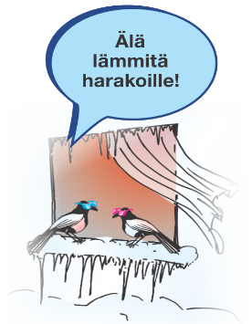
What did you learn?
It’s all about the attitude.
© Juha Puikkonen

Slide 40
This learning material contains good practices and principles for energy-efficient construction. The authors do not guarantee that the methods apply to any particular project as such. Any individual project must comply with its specific plans and designs. The original material was produced for EU’s Horizon2020 programme, the BUILD UP Skills project (Motiva Oy, TTS, TUT, 2016). Learning material team: Olli Teriö, Jukka Lahdensivu, Juhani Heljo, Jaakko Sorri, Ulrika Uotila, Aki Peltola, Jari Hämäläinen & Heidi Sumkin. This material has been updated in 2019 (Olli Teriö). www.motiva.fi/buildupskills
Thank you!

