Slide 1
Energy renovation of structures Moisture and microbial damage Supplementary insulation Renovation of structures

Slide 2
Energy saving possibilities
Energy saving measures that are usually economic:
supplementary insulation of roofs
supplementary insulation of external walls
repairing and replacing windows and external doors
sealing structures
possible supplementary insulation of the base floor
User behaviour greatly affects energy use:
the feel and comfort of the heat affect the need for heating
heat radiation increases the feel of heat and air flow reduces it
control of the energy use is very important especially after utility renovations.

Slide 3
The process of energy renovation
Before an energy overhaul, moisture damage, microbe damage, other damage and their causes must be explored.
The causes will be removed and damaged structures replaced.
Planning renovations is more challenging than designing a new building. Often an incorrect repair is the reason for decay and microbe damage.
When designing for energy efficiency, the moisture behaviour of the structure and the co-operation between old and new structures and the HVAC must be considered.
The design and the delivery contracts can affect the quality level of the design and its implementation.
In the building phase, the proper heat and moisture insulation and air tight joints are the essential points of quality.
Reasonable instructions on the use ensure the energy efficient use of the rooms, the production of good indoor air and other data that maintenance needs.

Slide 4
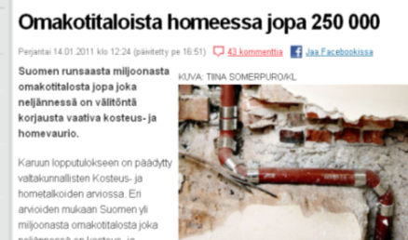
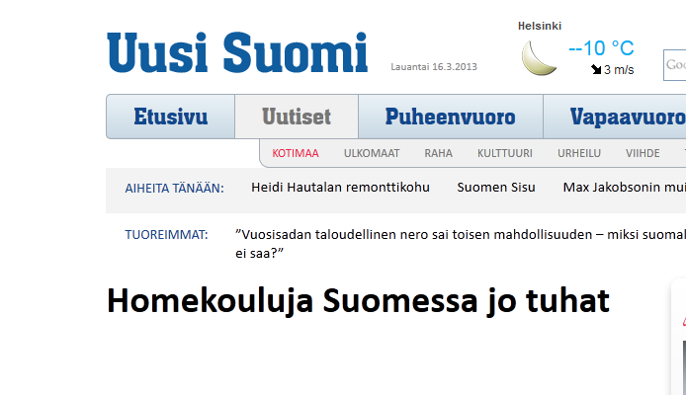
Signs of moisture and microbe damage
Signs of moisture damage
moisture and run marks on structures and surfaces
peeling of the coating, changes of colour, material swelling and lime on the brick or concrete
Changes in water metre readings, even when water is not used
Microbe damage needs to be investigated if there are:
stuffy or mouldy smells
symptoms of respiratory, eye and skin damage

Slide 5
Most common causes of moisture damage
Design errors and risky design solutions
Construction defects; moisture, air barrier and waterproofing damage
Ageing structures and materials
Lack of maintenance
Moisture caused by use of the building
Breakage of machines and water pipes

Slide 6
Microbe damage
Microbe damage develops if the moisture damage is not removed fast enough.
In indoor air microbes produce:
spores
cells and other particles
odourless or ill-smelling gases (the absence of odour does not guarantee that there is no microbe damage in the space.)
toxic metabolites, i.e. toxins
Humans react to microbes in different ways.
Microbes do not belong to the structures – they should be immediately removed and future development prevented.

Slide 7
Indoor air renovation
Find out the scale of the damages that has caused the problems to the indoor air and remove the causes.
The technical building inspection for moisture and the plans the building surveyor has checked are a good starting point for the indoor air renovation.
Remove or change mouldy and saturated materials.
Damaged materials that can be removed are cleaned mechanically, for example, with a cutter or by sandblasting.
A disinfectant compound or mould biocide should not be used
Can cause symptoms
Can increase toxins and mould
New structures must be made airtight and the airtightness of old structures improved.
Carefully clean and replace furniture and belongings in the damaged room. Cleaning mould from furniture is a job for a specialist.
Ensure the ventilation and the pressure ratios are adequate, also over the envelope, so the damage will not be repeated.

Slide 8
Supplementary heat insulation

Slide 9
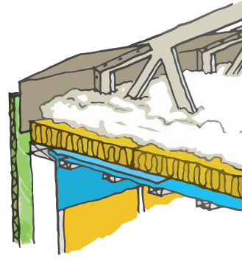
Supplementary insulation of the roof
Supplementary insulation can be installed above or under the old insulation or all old insulation can be changed.
Before laying the supplementary insulation
Repair damaged structures
Remove mouldy insulation
Dry any moist materials
Ensure water vapour proofing in working and utility through-holes are tight
Ventilation ducts are heat insulated.
The new supplementary insulation is laid on the old one and should be less dense than the old one.
Before installing the supplementary insulation above the old one, make sure the ventilation in the roof space is working, e.g., the wind controllers which are installed near the eaves.
A cold conducting hole often forms under the webs when the blow-in insulation sinks. It has to be checked and blocked up.

Slide 10
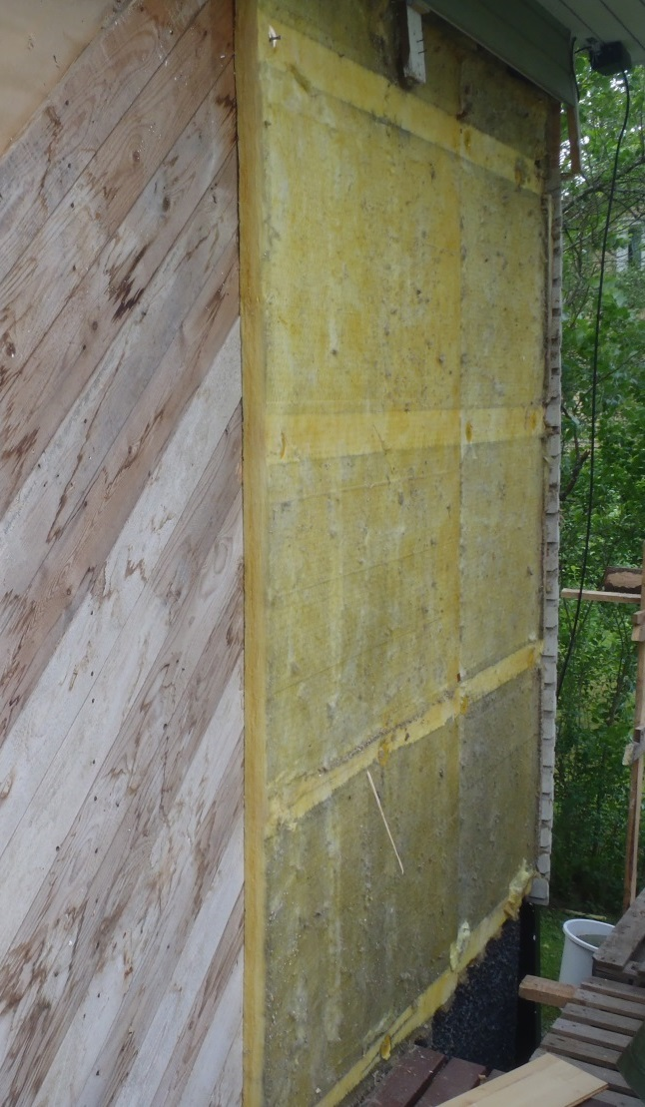
Supplementary insulation of external walls
When installing supplementary insulation, ensure that the inner moisture proofing is adequate.
The airtightness of the joints, the ventilation of the outer surface of the structure and the resistance to rainwater are important.
When the old external leaf is very damaged or the heat insulation is unsound, supplementary insulation should be added and a new external leaf installed.

Slide 11
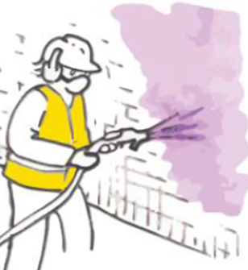
Insulated render over an old facade
The new heat insulation, which acts also as a backing, is installed over the old concrete external leaf.
The unevenness of the old facade should be levelled before installing the heat insulation.
In sheet metal work the plastering borders should be used
The plastering can be done with three coat plasterwork or a thin coat of plastering.
With three coat plasterwork moveable joints must be used
to prevent cracking. Mechanical fasteners have to be used to
secure the plastering.
With thin coat plastering, movement joints are usually used
only with the joints of the frame and are made by
movement joint profiles.
The joints are sealed with an expansive sealing strip or an elastic joint sealant.
Any construction moisture of the supplementary heat insulation is
led out through the outer surface.
The water vapour permeability of the plastering and the heat insulation should be adequate.
Joints and the junctions must allow stress based on thermal radiation and moisture movements.

Slide 12
Renovation of the concrete facade with boarding (1/2)
New heat insulation and a new surface using facing boards or wall cladding is fixed over the surface of the old facade.
No air gaps should be left between the supplementary heat insulation and the old structure – it will reduce the heat insulation.
If needed the old structure is levelled or straightened using insulation.
Bending heat insulations must be prevented.
A ventilation gap is left between the supplementary heat insulation and the facing board to remove the construction moisture.

Slide 13
Renovation of the concrete facade with boarding (2/2)
The ventilation gap must be continuous and the horizontal battens must have vertical ventilation.
Galvanized iron is usually used in the metal furring channel. Stainless steel is used in the fasteners.
Moisture movements and thermal radiation of the new boarding and the old structure are unequal.
Clearance must be taken into consideration in the fasteners and joints. The clearances must be made based on the construction plan and the manufacturer’s instructions.

Slide 14
Renovation of structures

Slide 15
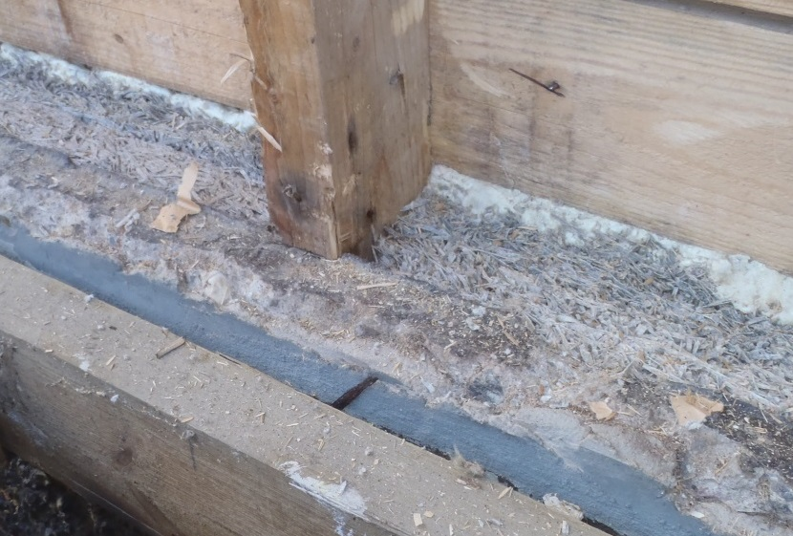
Renovation of a cellar wall
Moisture damage is common in the cellar walls because:
infiltration of the surface water to the wall
inactivity of the subsoil drain
leakage of the waterproofing
defective sealed penetrations
condensation of the indoor air humidity onto the wall.
Especially the inner supporting structure, heat insulation and the boarding of the cellar wall sustain moisture damage.
Before the supplementary insulation, waterproofing or tanking will be ensured and, if needed, replaced.
The damaged structure can be repaired either with plastic or stone aggregate -based heat insulation.
Calcium silicate board is recommended as inner supplementary insulation
Timber and other organic materials must not be used.

Slide 16
Renovation of a 'crawling space' base floor
The renovation of a 'crawling space' base floor is not usually economical.
Small renovations or supplementary installations are worth doing at the same time as other renovations, for example:
sealing the junction between the floor and the external wall.
Increasing heat insulation to the sides of the floor if the old insulation has collapsed (most worthwhile at the edges).
new insulation is installed with light pressure
moisture proofing, sealing the joints and the penetrations
The moisture technical functionality is very important:
boost the airing in the ‘crawling space’ by increasing the ventilation holes of the base wall
remove organic waste from the 'crawling space'
install the heat insulation on the ground of the 'crawling space' base floor
divert surface water away from the base wall
clean the subsoil drains.

Slide 17
Renovation of a ground slab
Moisture damage of a ground slab usually appears as damage to the floor covering and a microbe growth in the bottom parts of timber walls or floors.
Reasons for the damage:
rise of the water by capillary action to the base floor
inactivity of the subsoil drains
contact of the timber components with the ground
moisture in the timber battening above the concrete slab due to defective heat insulation or a coating too airtight
Renovation:
replacing the heat insulation of the damaged floor or wall structures
damp-proof strips under the new battens in the floor
damp-proofing between the base plate and the elevation
sealing joints in the base floor and the penetrations (sealing alone is a temporary option).

Slide 18
Renovation of the windows
The defective airing of the interfenestration, the failures of ventilation or the streaming of the inner sealing can result in condensation of the indoor air on the surface of the window or steaming up of the window.
The perished fronting or leakage of glazing bead and sealing compound can cause the window sash to decay.
Renovation methods can be:
changing the decayed window sash
installing new seals
repairing the sheet metals and their junction to waterproofing.
Notice when renovating aluminium-faced timber windows
air the gap between aluminium and timber parts
drain the condensation water
make fixings compatible with aluminium .

Slide 19
Replacing windows and extra panes of glass
The new window should be fitted in the same place as the old window.
If the amount of heat insulation is to be increased when removing the windows, the new window should be fitted with the same level of heat insulation.
The old window can be replaced with the frames or the old frame can be made thinner by shaving and the new frame installed over the old one.
Replacing frames is suitable especially when the facade will be renovated.
Shaving the frame is suitable if removing the frame may damage the facade or is otherwise challenging to remove.
An extra pane of glass can be installed inside the window, outside the window or between the windowpanes. When installing an extra pane inside or between, extra focus should be put on sealing.

Slide 20
Balcony glazing increases energy efficiency
Glazing increases heat and sound insulation at the back wall of the balcony. It decreases draught and the need for maintenance of the balcony.
Balcony glazing can be made with a glazing system which can be opened completely or by a fixed structure which partially opens and airs the glazing system.
Airing of the balcony needs to be ensured so the inner moisture will not condense on the balcony glass or other surfaces.
Glazing increases the life of the balcony because the structures stay drier.

Slide 21
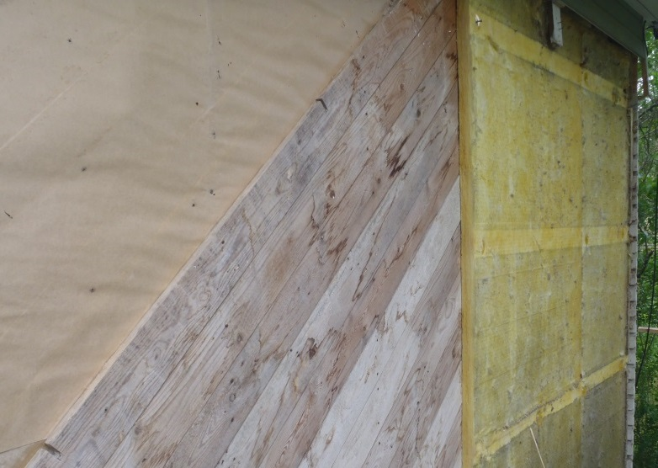
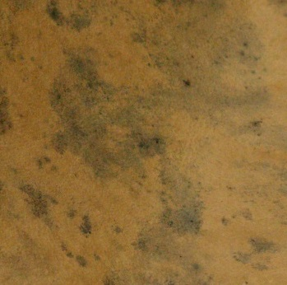
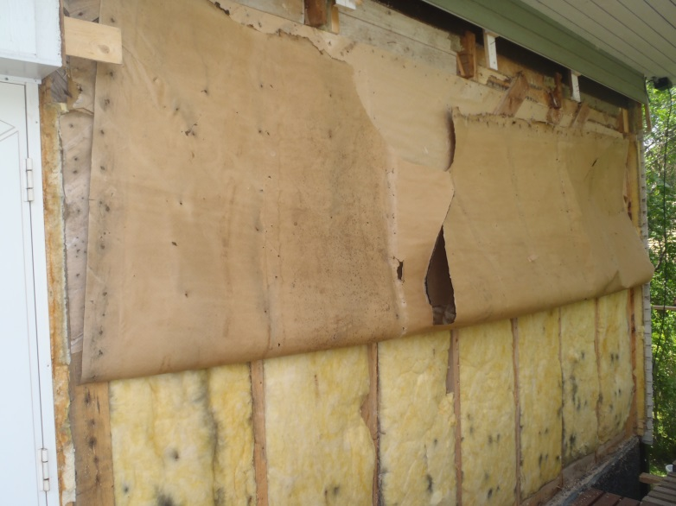
Example: Mould / energy renovation
Starting situation:
The house was built in 1968
5 cm thick supplementary heat insulation is installed above the diagonal boarding.
Large section of the tar paper under the diagonal boarding has become mouldy.
In 2000 the roof was replaced and new bedrooms were built upstairs.

Slide 22
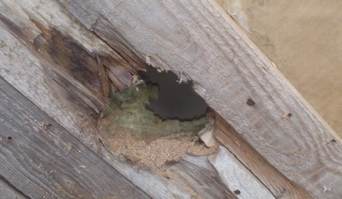
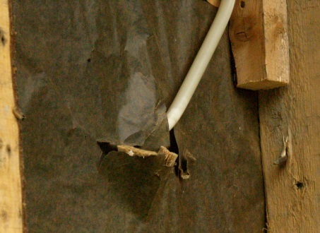
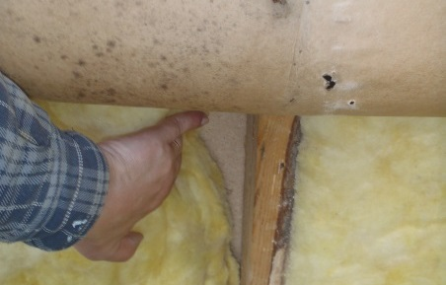
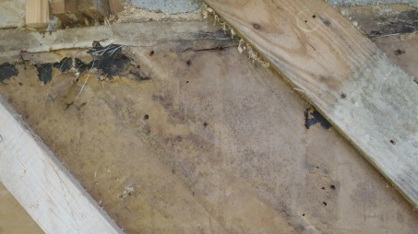
Reason for damage
Very bad or defective sealing of the ventilator
Defective sealing of electrical installations in the vapour barrier
Missing vapour barrier in the draught lobby
Ageing materials

Slide 23
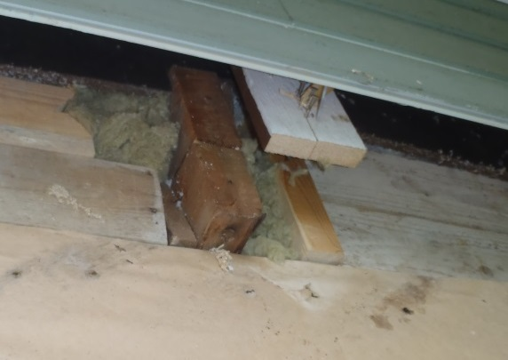
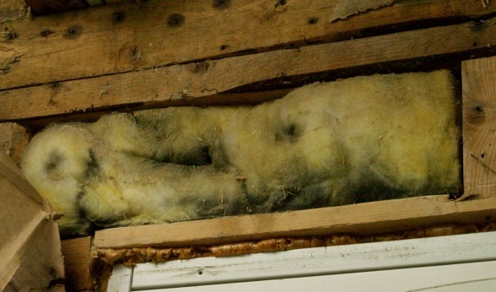
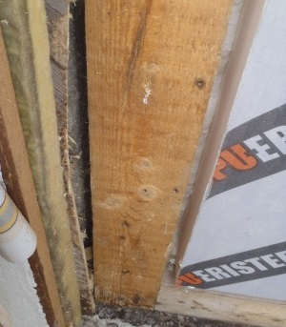
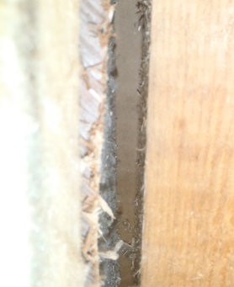
Defects of heat insulation
The wind protection of the joint on the roof is defective – air is warming in the structure and conducted to the outdoor air.
Mineral wool is not tight against the surface – inner convection.
Mineral wool does not fill the gaps between timber studs
- Air is going between the warm and cold surface (strong inner convection).

Slide 24
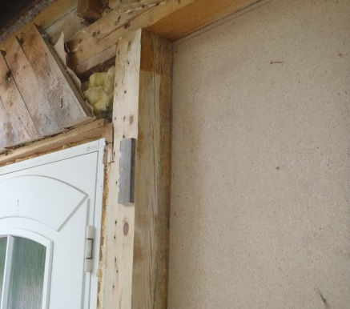
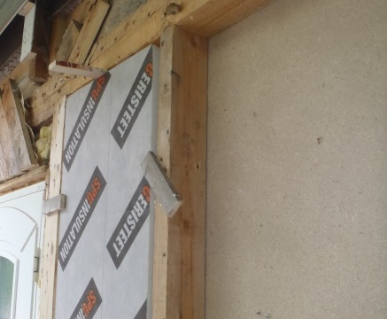
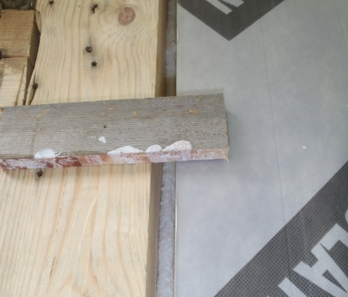
Renovation
Removal of mouldy insulation and cleaning of the timber frame with a cutter and by scraping.
Installing new heat insulation.
Sealing with foam in two sections.
The renovation doubled the thermal resistance (u-value 0.44 → 0.22). Sealing improved many times.

Slide 25
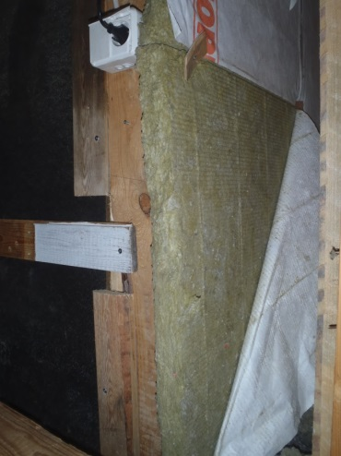
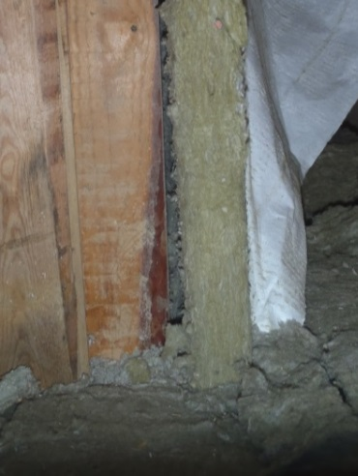
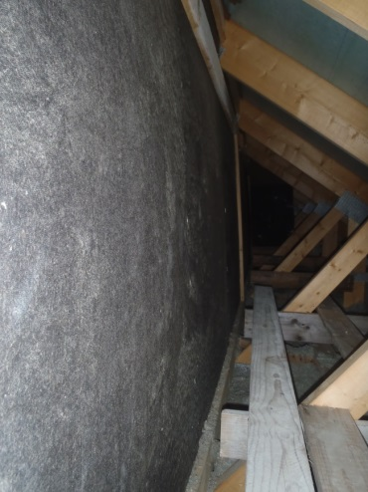
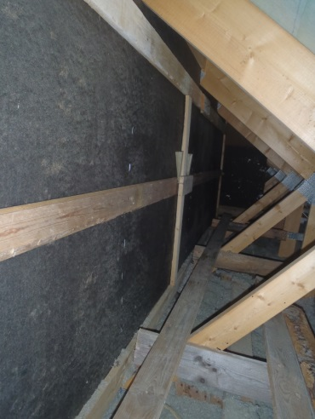
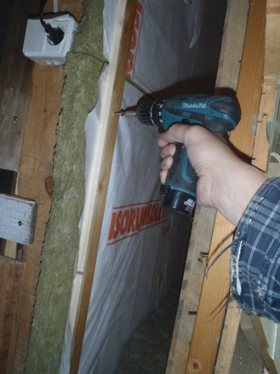
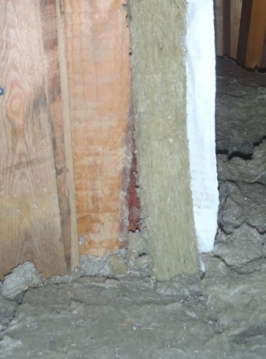
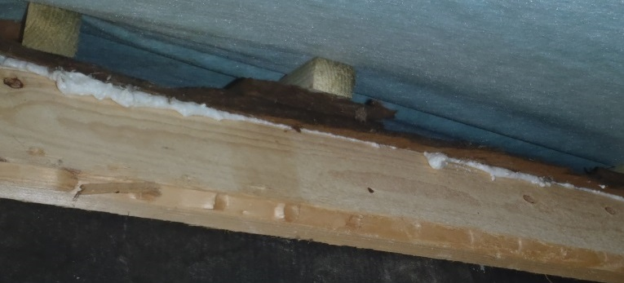
Finally improve airtightness
The sheathing board wool is loose from the frame.
The sheathing board is blistering.
The sheathing board is tightened up
against the frame with the batten.
The wool and the breather paper are tightened up to the frame with battens.
The gap between the roof and the wall is
sealed up with SPU-foam and wedges.

Slide 26
Remember
The starting situation must be thoroughly assessed.
Consider the effects on health and energy efficiency when planning the renovation.
Acquire or demand the plans that specialists have drawn up.
Especially, take account of heat insulation, moisture questions, air proofing and microbe damage.
Joints and details are crucial.
In the same renovation, the comfort and quality of the residence, for example lighting, indoor air quality and heat comfort should also be improved.
Educating the users is very important because users significantly affect the energy consumption.

Slide 27
Further details
Web sites of Ministry of the Environment
http://www.hometalkoot.fi/ (in Finnish)
http://www.korjaustieto.fi/ (in Finnish)
Organisations:
Indoor air organisation
www.sisailmayhdistys.fi (in Finnish)
Allergy and asthma union
http://www.allergia.fi/in-english/
Asumisterveysliitto
www.asumisterveysliitto.fi (in Finnish)
The Organisation for Respiratory Health
www.hengitysliitto.fi (in Finnish)

Slide 28
Thank You!

