Slide 1
Energy efficient connections in stone houses

Slide 2
Energy efficient stone structures NB
Structures are made airtight.
Plastic insulations more common in stone houses. During installation remember:
  At least 10-20 mm jointing margin along edges of the board.
  Tongue and groove joints foamed before attaching.
  Join to clean surfaces; clean insulation with compressed air; remove paste from concrete surfaces.
  Join at least in two phases allowing airtight film to develop.
  The joints of vertical and horizontal structures are very important. Heat and moisture deformations and long term resistance must be considered in stone and timber structures.

Slide 3
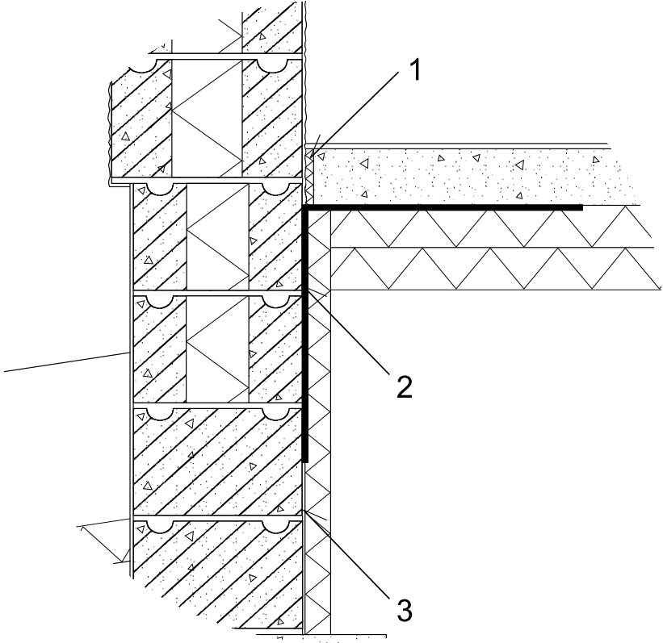
Connection between concrete slab on ground and exterior wall – At first exterior wall
Footing blocks coated on both surfaces down to the footing.
Bitumen-polymer membrane glued to the ashlars and turned on the floor insulation and under the slab.
10 mm-wide cellular polyethylene strip fixed between slab and wall.
Joint sealed with elastic sealing compound because of the shrinkage of the slab.
4
3
2
1

Slide 4
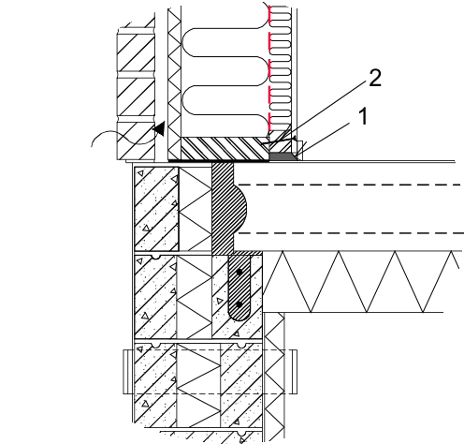
Ventilated base floor made of stone
The bitumen-polymer membrane is installed under the wall as a capillary break and to ensure the end joint is vapour proof.
The horizontal joints between concrete structure and foundation block are air proof if concreting is made carefully.
Connections between elements are sealed with plaster coat.
Air proof foil of timber wall is tightened between the horizontal battening and the base plate of wall.
The gap between the bottom of the wall and the floor slab is sealed with polyurethane foam.
4
3
1
5
2

Slide 5
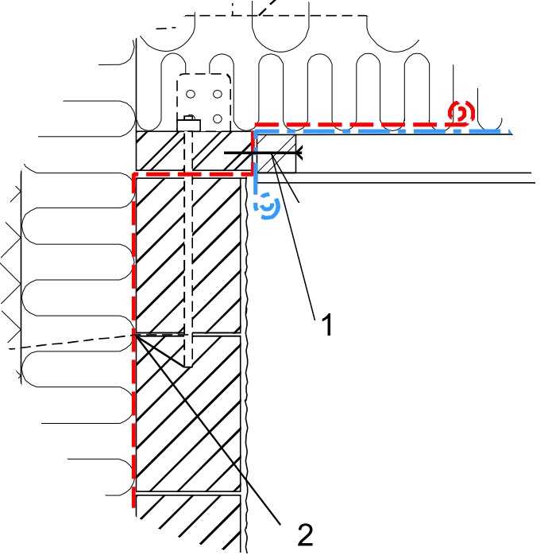
Connection between timber roof and stone wall eaves
A 1 metre-wide vapour barrier membrane fitted above the block wall.
When making the roof, the vapour barrier of the wall is overlapped with the vapour proofing of the roof.
The connection is pressed tight with the screw fastening (k300) of the horizontal battening.
2
3
1

Slide 6
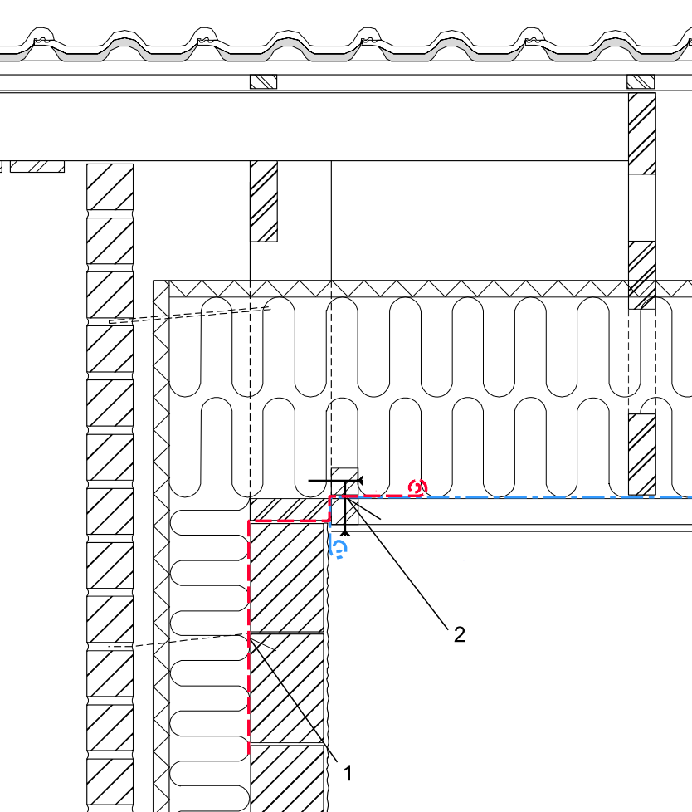
Sealing the connection between a timber roof and stone exterior walls with a vapour barrier membrane
A vapour proof plastic strip is set over an ashlar wall.
The strip is stapled to the batten from inside until building the ceiling starts. The batten is also another compression batten in the connection.
The vapour-proof foil is overlapped with the vapour proofing of the roof and is pressed between battens using separate screw battens (screw fastening k300)
2
3
1

Slide 7
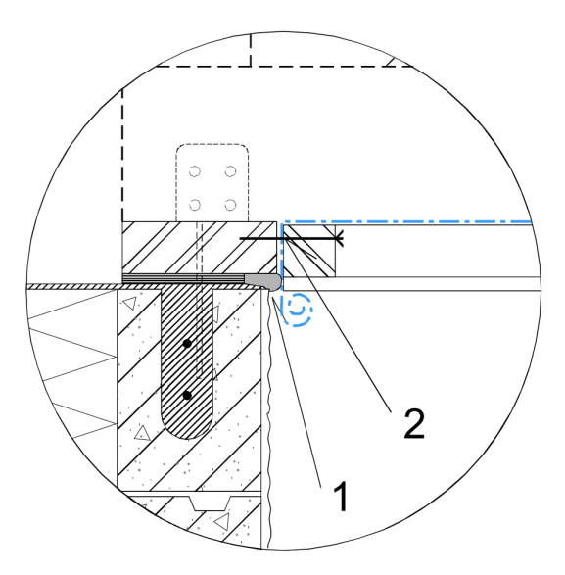
Connection between an insulated block wall and a timber roof–levelling under the head plate
The air barrier foil of the roof is tightened against the header course by battening (screw fastening k300).
The roof truss is levelled under the head plate of the wall and the gap between the head plate and ashlar is foamed.
2
1

Slide 8
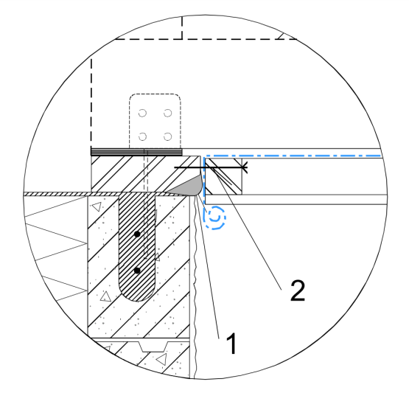
Connection between an insulated block wall and a timber roof–levelling over the head course
The air barrier foil of the roof is tightened against the header course by battening (screw fastening k300).
When roof truss is levelled over the head plate of the wall, the chamfered header course is installed over the ashlar wall. The gap is foamed.
2
1

Slide 9
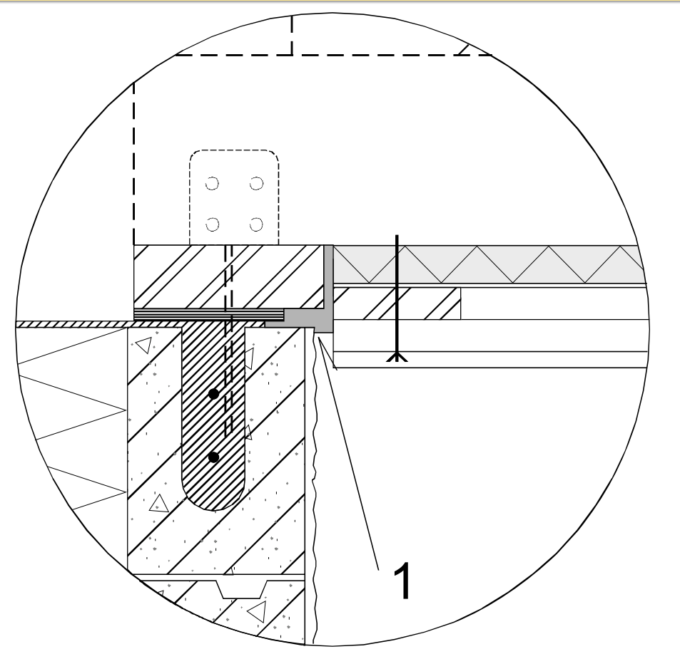
Vapour proofing of a roof with a cellular plastics insulation panel
Roof truss is levelled under the header plate
Polyurethane foaming between the board, header plate and ashlar.
1
2

Slide 10
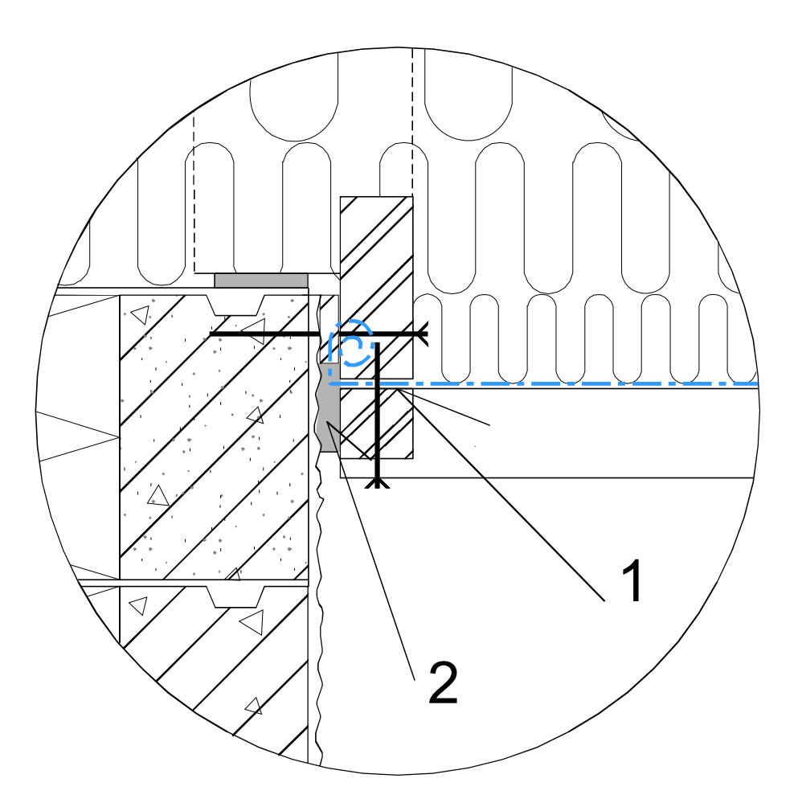
Sealing and joints between exterior stone walls and a timber roof - diagonal ceiling
A batten, parallel to the roof, is fastened to the end wall by a spacer
The vapour-proof foil of the roof is pressed between the batten fastened to the wall and the counterforts of the gable end (screw fastening k300).
The gap between the spacers, the counterfort and the ashlar is sealed with polyurethane foam.
1
2
3

Slide 11
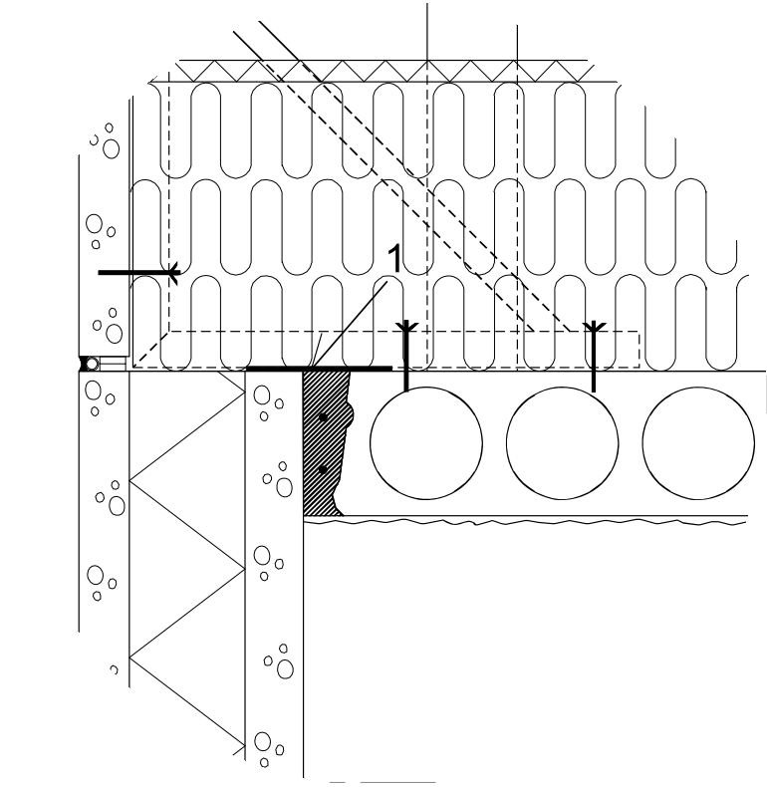
Connection between concrete sandwich elements and hollow core slabs: non-bearing wall
Airtightness of the joint is ensured with welded or glued bitumen-polymer membrane.
1

Slide 12
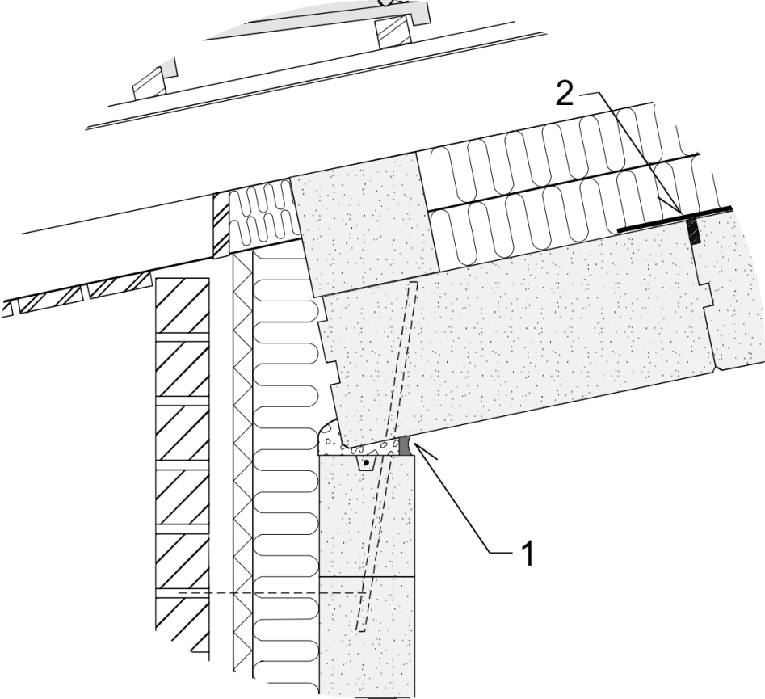
Joints between exterior walls of lightweight concrete house and roof: eaves
The connection is sealed with foam.
Seal is made sure with elastic caulking.
It is recommended to install 200 mm stick-on bitumen-polymer membrane strips over the roof element junctions.
3
1
2

Slide 13
Sealing window frames
The window is sealed with polyurethane foam
A ventilation gap should be left at the outer edge of window
The polyurethane foam junction should come up to the gap between the inner leaf of the element and the frame
1
2
3

Slide 14
Consider: What are the critical work phases in an apartment building construction site concerning energy efficiency and quality?
Caulking and sealing gaps of the heat insulation in the elements.
Making concrete element joints airtight
Fastening and jointing heat insulation that is installed on site
Covering the floating works of the base floor and the external walls
Taking cross-measures of the windows and doors; adjusting the entrance and jointing and caulking the frames
Sealing joints of vertical and horizontal structures and considering the transformations

Slide 15
Remember
Thermal insulation tight against the frame and surfaces
Soft thermal insulation with light pressure
Hard thermal insulation foamed 1-2 times around. The gap for foam should be 10 – 25 mm.
Vapour-proof foil should not break. It should be stalled in such a way that movement of the frame is allowed.
The joints of vapour-proof foil should be pressure fastened if possible.
In concrete houses, the lower joint is the most critical joint. In some cases the plaster coat of the floor also seals the joint.
The structures should be tight for decades. When choosing materials, consider, for example, vapour-proof tapes.
Taping alone is not enough because tapes perish and do not withstand movements due to heat, moisture and snow load.

Slide 16
Thank You!

