Slide 1
Energy Efficient Construction and Training Practices:
Basics

Slide 2
Energy and moisture of building site
Introduction
Heat transfer
Humidity and condensation point
Correlation between heat and moisture

Slide 3
Construction site heating
The construction site is heated to:
increase the firmness of the concrete
dry the structures
create good working conditions

Slide 4
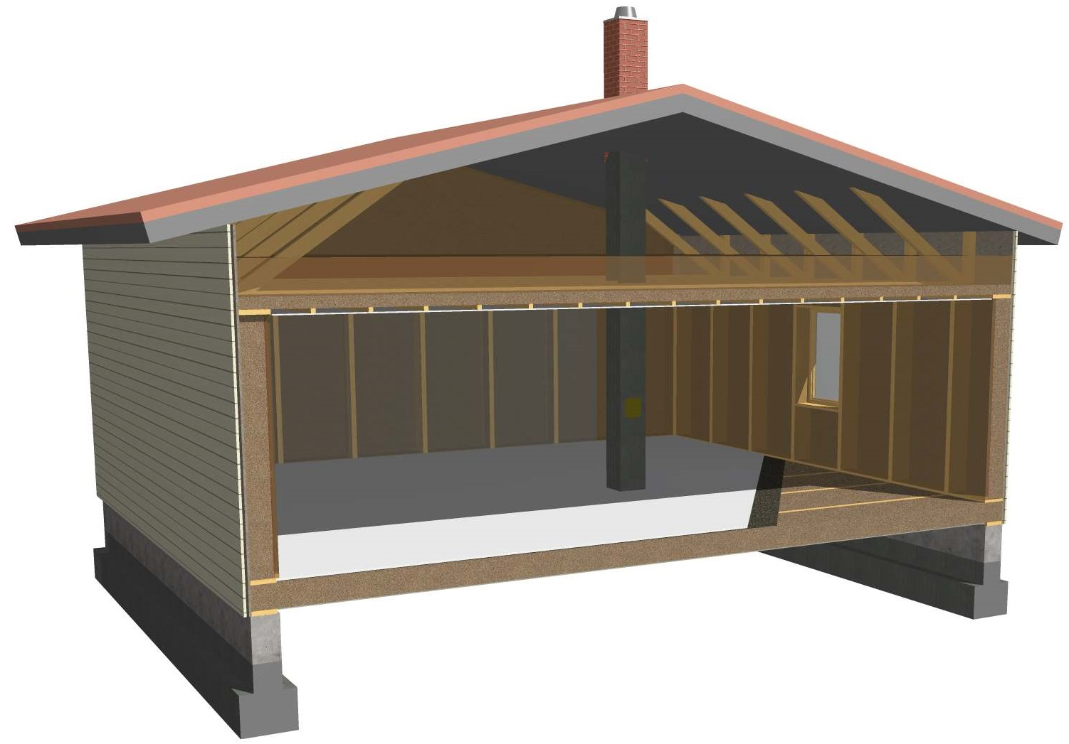
Three ways of heat transfer
Convection
in air or smoke
Radiation
for example windows
Conduction
through the structures
Speculation: Why are the floors of old houses often cold?

Slide 5
Three ways of heat transfer
Answer: Warm air rises. If the roof is not tight, the
warm air rises to the roof space and the cold air flows into the room from windows and door gaps.

Slide 6
Thermal transmittance (U-value) represents the capacity of heat insulation of different structural elements. The smaller the U-value, the better the heat insulation.
U-value W/(Km²) | Warm rooms, building regulation year
 | >1969 | 1969 > | 1976 > | 1978 > | 1985 > | 10/2003 > | 2008 > | 2010 > | 2012 > | 2018 >
Exterior wall | 0,81 | 0,81 | 0,40 | 0,35 | 0,28 | 0,25 | 0,24 | 0,17 | 0,17 | 0,17
Ground supported floor | 0,47 | 0,47 | 0,40 | 0,40 | 0,36 | 0,25 | 0,24 | 0,16 | 0,16 | 0,16
Crawlway floor | 0,47 | 0,47 | 0,40 | 0,40 | 0,36 | 0,20 | 0,20 | 0,17 | 0,17 | 0,17
Basefloor adjecent to outdoors | 0,35 | 0,35 | 0,35 | 0,29 | 0,22 | 0,16 | 0,16 | 0,09 | 0,09 | 0,09
Roof | 0,47 | 0,47 | 0,35 | 0,29 | 0,22 | 0,16 | 0,15 | 0,09 | 0,09 | 0,09
Door | 2,20 | 2,20 | 1,40 | 1,40 | 1,40 | 1,40 | 1,40 | 1,0 | 1,0 | 1,0
Window | 2,80 | 2,80 | 2,10 | 2,10 | 2,10 | 1,40 | 1,40 | 1,0 | 1,0 | 1,0
Massive wood wall |  |  |  |  |  |  |  |  |  | 0,4
In the 1970s and 1980s huge steps were taken in energy efficiency.

Slide 7
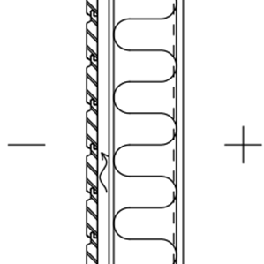

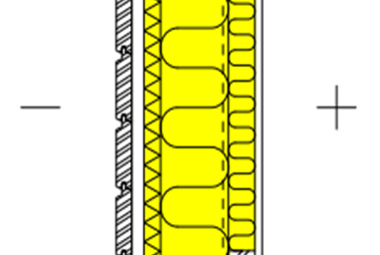
Examples of wall structures from different years – mineral wool insulation
Year | Building regulation U-value [W/(K·m²)] | Thickness of insulation [mm] | Insulation layers [mm] | U-value of structure [W/(K·m²)]
1976 | 0,4 | 100 |  | 0,37
1978 | 0,35 | 125 |  | 0,32
1985 | 0,28 | 150 |  | 0,27
2003 | 0,25 | 175 | 125 + 50 | 0,22
2007 | 0,24 | 175 | 125 + 50 | 0,22
2010 | 0,17 | 205 | 30 + 125 + 50 | 0,17
2012 | 0,17 | 205 | 30 + 125 + 50 | 0,17
2018 | 0,17 | 205 | 30 + 125 + 50 | 0,17

Slide 8
Example:
Calculate how much heat is conducted during the day through a one-metre wide door.
The inside temperature is 21 ºC and outside temperature is -15 ºC.
Area 1.0 m x 2.1 m = 2.1 m²
Temperature difference 36 K
Total heat transfer coefficient = 1 W/Km²
=2.1m² x 36K x 1W/Km² x 24h = 1.8kWh
How much heat is conducted through the door from 1980s
in a day?
=2.1m² x 36K x 1.4W/Km² x 24h = 2.5 kWh

Slide 9
Example:
Calculate: How much money can be saved in a year by insulating 120 m² of the roof from the building regulation level of 2008 to the present level?
Heating degree day value in Helsinki is 3878 Cºd.
The price of energy is 0.12 €/kWh.
Area 120 m²
The improvement in total heat transfer coefficient 0.15–0.09 = 0.06 W/Km²
The difference of needed heating energy
= 120 m² x 0,06W/Km² x 3878Cºd x 24 h/d= 670118 Wh=670 kWh
Saving 0,12 €/kWh x 670 kWh = 80 €
What would be the saving if original level was from 1985 (0,22 W / Km² ⁾?
The improvement of total heat transfer coefficient 0.22–0.09 = 0.13 W/Km²
The difference of heating energy needed
= 120m² x 0.3W/Km² x 3878Cºd x 24h/d = 1452 kWh
Saving 0.12€/kWh x 1452 kWh = 174 €
What about in a 1960s house?
Answer: 630 € in a year

Slide 10
Heating degree days 1981-2010
 | I | II | III | IV | V | VI | VII | VIII | IX | X | XI | XII | Vuosi
Maarianhamina | 592 | 567 | 551 | 406 | 216 | 34 | 3 | 17 | 135 | 308 | 432 | 542 | 3803
Vantaa | 682 | 640 | 586 | 376 | 146 | 16 | 2 | 21 | 158 | 348 | 497 | 625 | 4097
Helsinki | 647 | 612 | 566 | 383 | 153 | 11 | 1 | 12 | 125 | 316 | 464 | 588 | 3878
Pori | 677 | 633 | 585 | 389 | 181 | 26 | 3 | 25 | 171 | 352 | 497 | 622 | 4161
Turku | 663 | 625 | 575 | 377 | 161 | 19 | 2 | 18 | 149 | 338 | 486 | 608 | 4021
Tampere | 724 | 675 | 612 | 400 | 176 | 28 | 5 | 34 | 192 | 382 | 529 | 667 | 4424
Lahti | 726 | 677 | 610 | 395 | 159 | 20 | 4 | 31 | 191 | 383 | 528 | 668 | 4392
Lappeenranta | 759 | 699 | 621 | 403 | 165 | 22 | 5 | 28 | 184 | 386 | 546 | 692 | 4510
Jyväskylä | 785 | 721 | 646 | 440 | 206 | 40 | 10 | 56 | 227 | 414 | 569 | 718 | 4832
Vaasa | 719 | 666 | 619 | 424 | 214 | 29 | 5 | 35 | 192 | 377 | 526 | 663 | 4469
Kuopio | 812 | 741 | 653 | 445 | 198 | 31 | 7 | 38 | 194 | 400 | 571 | 735 | 4825
Joensuu | 826 | 753 | 665 | 456 | 216 | 39 | 10 | 47 | 215 | 416 | 589 | 752 | 4984
Kajaani | 864 | 777 | 695 | 479 | 251 | 57 | 17 | 75 | 245 | 441 | 618 | 785 | 5304
Oulu | 824 | 742 | 677 | 465 | 249 | 47 | 9 | 55 | 224 | 423 | 593 | 749 | 5057
Sodankylä | 946 | 838 | 760 | 548 | 345 | 106 | 49 | 136 | 316 | 523 | 722 | 891 | 6180
Ivalo | 923 | 819 | 755 | 557 | 377 | 146 | 69 | 147 | 318 | 523 | 722 | 875 | 6231
(Finnish Meteorological Institute)

Slide 11
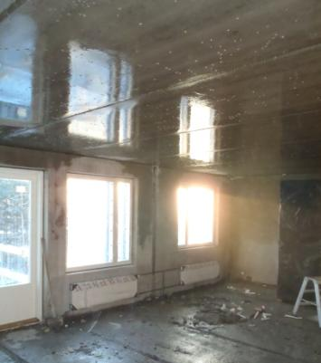
Air humidity and condensation point
Example:
In December the temperature is
-20 ºC outside.
The roof work is slightly behind schedule.
The roof insulation is not installed.
The heating has been just turned on.
The floor slab is still cold. Air
reaches condensation point.
Notes:
11

Slide 12
Basic terms
Absolute humidity is the total amount of water vapour present in a cubic metre of air.
The maximum limit of absolute humidity is saturated humidity. It defines how much water vapour the air can contain at a certain temperature. Hot air can contain more water vapour than cold air.
The condensation point (condensation point temperature) is the temperature at which saturated humidity is reached.
Relative humidity defines what percentage of the saturated humidity of the current temperature is absolute humidity.

Slide 13
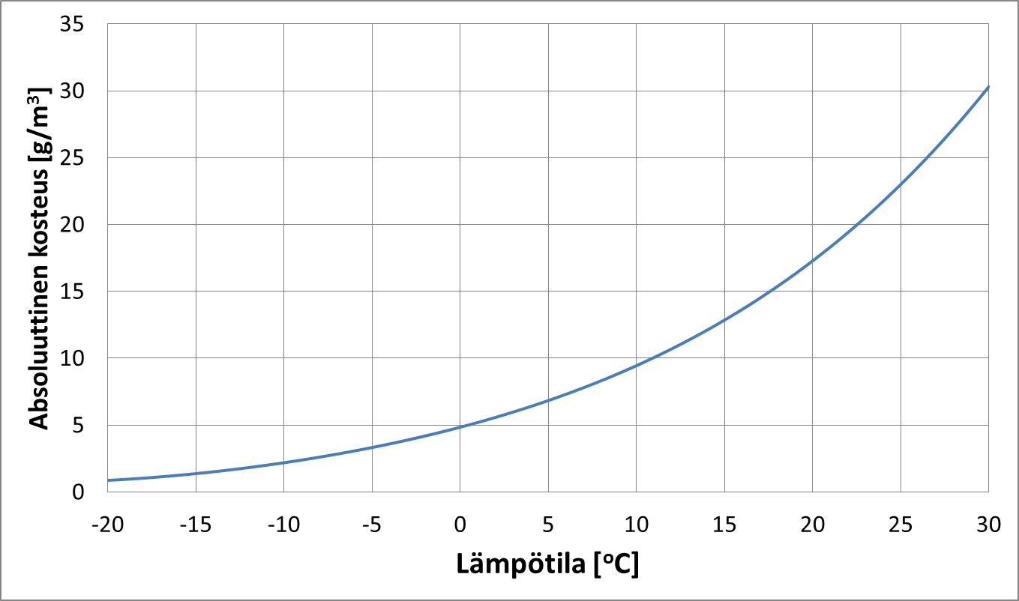
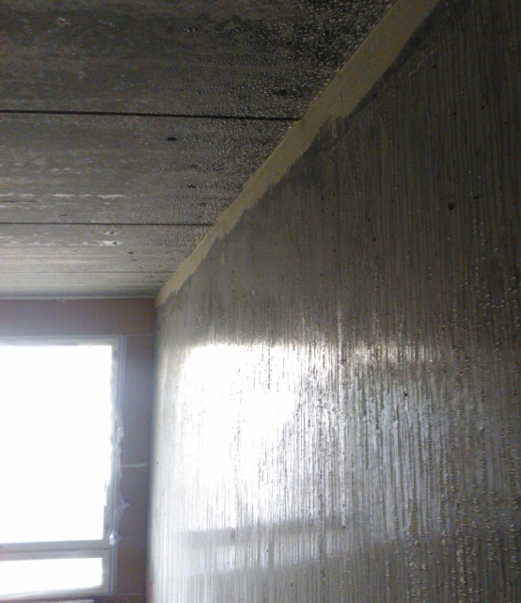
Condensation point
Absolute humidity [g/m³]
Temperature [ºC]
The curve illustrates the highest amount of air humidity at different temperatures.
In the picture air humidity has condensed on the cold wall.
Questions:
When can the condensation point be reached inside a structure?
When is the condensation point harmful and when is it not?
Harmful: In winter, to the inner surface of the external leaf of a sandwich element. When the ventilation works, the condensation is harmless.
Harmless: The under surface of a sheet metal roof when underlay is under the sheet metal.

Slide 14
Drying
Water evaporation binds energy.
About 10% of site energy consumed in concrete work goes to the evaporation of water.
Evaporated water is transferred to outdoor air through ventilation. Heating the ventilation accounts for half the total energy consumption.
Concrete needs to dry several weeks before it is possible to start coating work.
Drying must be slow in the early stage in order to avoid season cracks.
The plastic shield on the concreting and curing slow down the drying proper.
Proper drying significantly affects the energy consumption and ensures the quality and the schedule of construction.

Slide 15


Example
While making concrete, about 180 litres of water is used per cube of concrete.
60-70 litres of water combine with concrete. At balance level, concrete contains
30-40 litres of water.
There are 70-90 litres of water to be evaporated.
Evaporated water amounts to 70-90 litres.
600 litres
How much water evaporates from a slab 80 mm thick and 100 m² wide?

Slide 16
Question
How much energy is consumed by water evaporating from a concrete cube?
Evaporated water = 80 litres
The heat of evaporation = = 2260 kJ/kg
80 kg x 2260 kJ/kg = 180800 kJ =180.8 MJ =
50 kWh
(0.12 € /kWh x 50 kWh = 6 €)

Slide 17
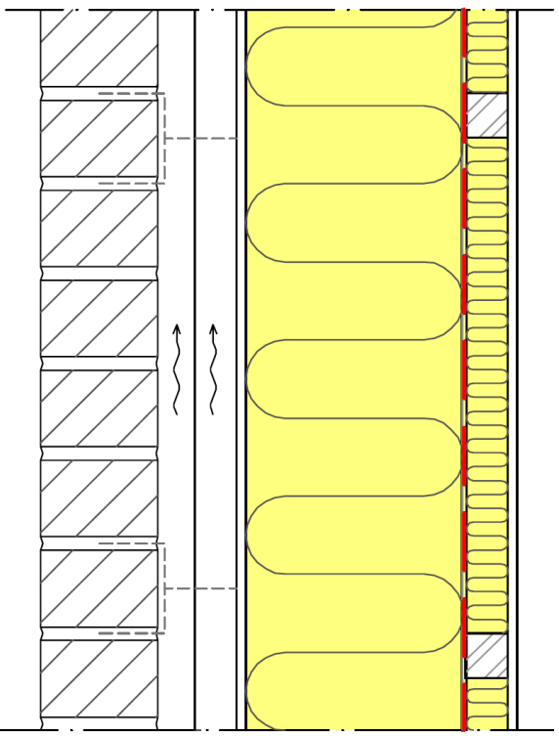
Moisture movement in a building element without a vapour barrier
+
-

Slide 18
Moisture movement in a building element with installed vapour barrier
+
-

Slide 19
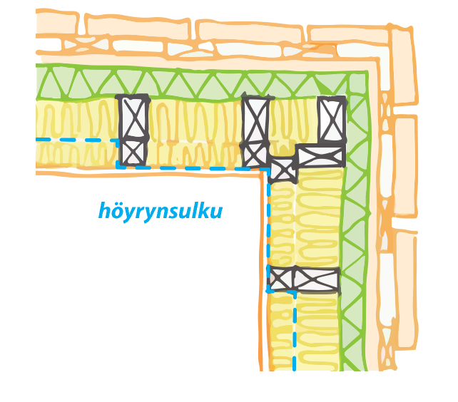
Moisture proofing
Question:
How is the vapour barrier installed in the corners of a building?
Draw a horizontal section of
the corner.
-
+
Vapour barrier

Slide 20
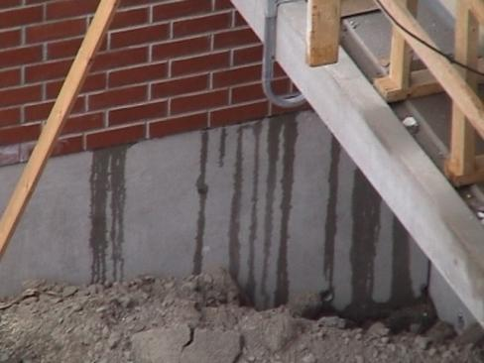
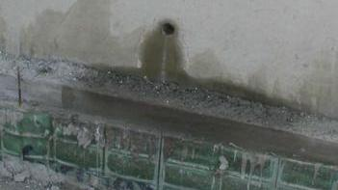
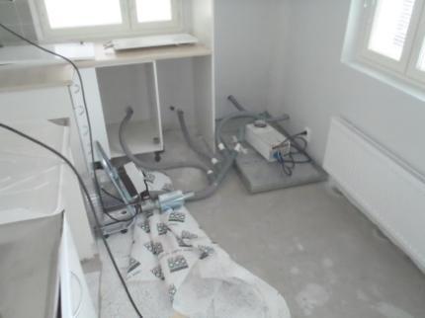
Construction moisture can be released by seepage, by evaporation or, in the worst case, by mechanical drying.
For example, freezing water in the insulation of a sandwich element can ruin the building materials when it melts.
The structures must be designed in a way that they dry by ventilation.
The structures should stay dry during installation work. The ventilation systems of a structure must be made properly.

Slide 21

Remember to ventilate!
(Juha Puikkonen Innoverkko)

Slide 22
The effect of ventilation on site conditions
35
30
100 %
Absolute humidity [g/m³]
25
80 %
20
60 %
15
40 %
10
5
20 %
0
-
20
-
15
-
10
-
5
0
5
10
15
20
25
30
o
Temperature [C ]
Mollier diagrams show that:
when outdoor temperature is less than 0 °C, the cube of air consists of max 5 grams of water vapour.
When the temperature inside the building site is 15 °C and RH 80 %, the cube of air consists of 10 grams of water vapour.
when the air exchanges in the site is 10 000 rm³ per hour, the exiting water amount is 50 litres.

Slide 23
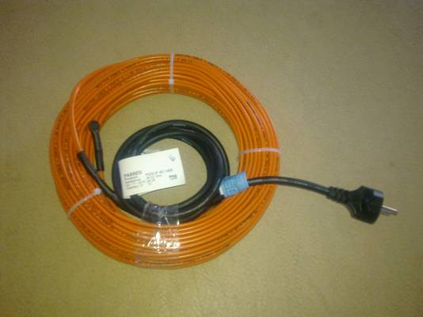
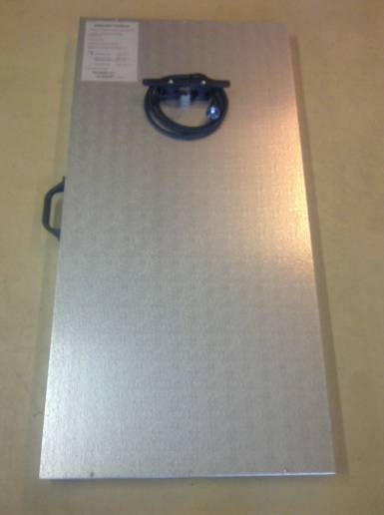
Raising the temperature of concrete by 10 degrees almost always halves the drying time regardless of the drying circumstances
By using heating cables and an infra dryer the heat is focused where it is specially needed.

Slide 24
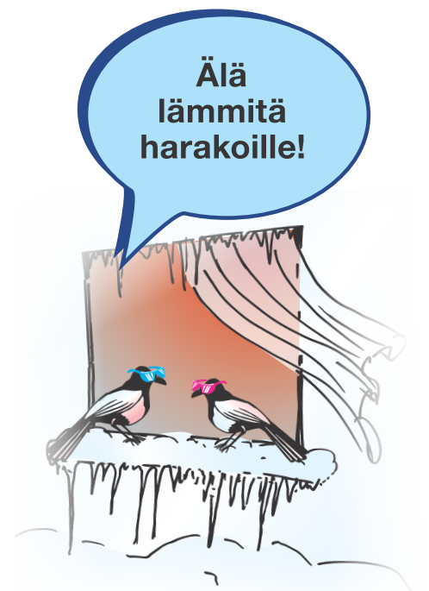

Don’t heat us!
An inch is enough for ventilation

Slide 25
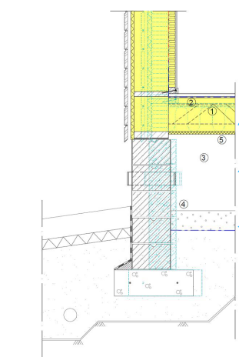
Working order of crawling space!
How the wind shield board (5) should be installed to the Soffit?
  The shielding board must be resistant to water.
  Notice that the shielding board must cover all timber structures.
  The floor and junctions must be made airtight.
09/03/2020

Slide 26
Discuss in pairs:
Air-tight construction or breathable construction?
A breathable construction does not mean air movement; it is about the ability of materials to absorb and release vapour.
According to current thinking, the construction needs to be airtight, and good indoor air is achieved by ventilation.
Who wants to breath the air flowing through old structures?

Slide 27
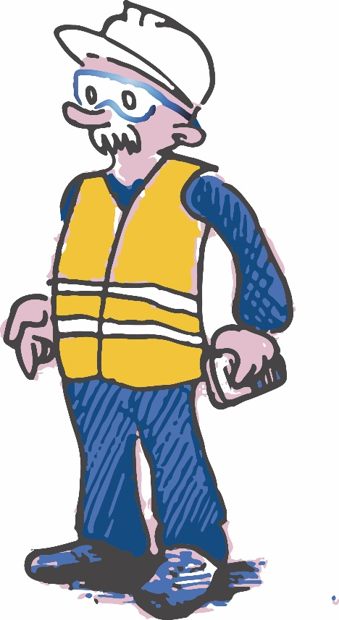


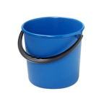
Do you know that burning 33 kg of gasoline produces over 53 kg water vapour!
3 L
10 L
10 L
10 L
10 L
10 L

Slide 28
Thank You!

