Slide 1
Controlling the condition and drying of the structures in the building site

Slide 2
Challenges of controlling site conditions
Thick structures of envelope, cooling and drying deceleration
Slow-drying structures:
  Solid concrete structures
  Floating concrete floors
  Closed roofs
  Remaining water in hollow-core slabs
  External wall insulation
Complicated structures
  Terraces
  Garage roofs
Distortions due to moisture
  Curved floors and cracking
  Cracked floors

Slide 3
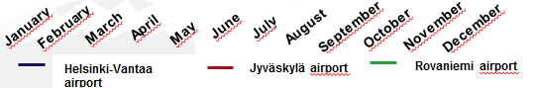
Air humidity and water amount
The water amount (g/m³) of outdoor air is high in summer and low in winter.
During the winter RH is high and
during the summer low.
Water vapour amount of air g/m³
Outdoor air relateive humidity %
February
April
June
July
October
January
March
May
August
November
September
December
Helsinki-Vantaa airport
Jyväskylä airport
Rovaniemi airport
The water of indoor and outdoor air tries to find a balance which causes the pressure of water vapour in the structures.
The water between structure and air also tries to find a balance.
That causes either the drying of structures or the saturating of structures.

Slide 4
Releasing construction moisture from concrete
Material | Water content l/m³ |  |  | Drainage water amount l/m³
 | Building phase precasting moisture | Chemically hydrate water | Balanced humidity with air of RH 50%
Concrete K15 | 180 | 40 | 25 | 115
Concrete K25 | 180 | 60 | 30 | 90
Concrete K40 | 180 | 70 | 40 | 70
Brick | 80 | - | 10 | 70
Wood | 60 | - | 40 | 20

Slide 5
Estimating drying time of concrete
Rules of thumb and guesses:
Concrete dries 1 cm per week until 4 cm.
Thickness exceeding 4 cm requires 2 weeks per additional cm.
Thickness exceeding 6 cm requires 4 weeks per additional cm.
In other words 8 cm thick concrete must be allowed to dry at least (4 x 1) + (2 x 2) + (2 x 4) = 16 weeks.
Rules of thumb can be used for schedule planning NOT the reason for starting the coating works.
When schedule is tight, fast drying concrete can be used. Drying shrinkage of fast drying concrete is bigger which increases the risk of cracking.

Slide 6
Factors affecting the drying time
Drying
High-strength concrete dries even two times faster than normal concrete.
Structure that dries on single orientation takes 2-3 times longer to dry than double oriented structure.
Raising the temperature of concrete by 10 degrees usually halves the drying time.
Reduction of air relative humidity from 60% to 50%, accelerates the drying time approx. 20%.
Relative humidity under 50% doesn’t significally accelerate drying. RH over 60% significally slows drying.
Resaturation of concrete during the drying phase increases the drying time 1.4 – 2 times
The target level of relative humidity of a structure varies with coating material and affects to a drying time.

Slide 7
Exercise:
Plan the production of a ground slab that dries as fast as possible
Different ways to speed up the drying of concrete:
Low water-cement ratio and water-reducing agent in concrete
Embedded-wire heating cables installed in concrete reinforcement
Pre-heating on site and high temperature on site
Blast protection of casting for 1-2 weeks
Air humidity approx. 50% and air temperature over 20ºC

Slide 8
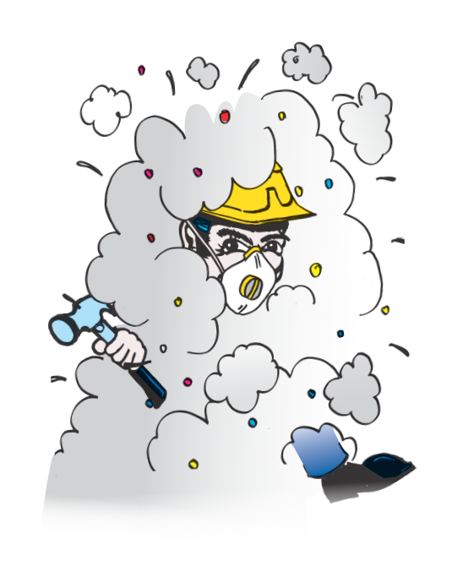
Remember to ventilate
Figure Juha Puikkonen Innoverkko

Slide 9
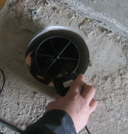
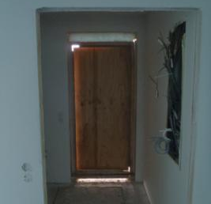
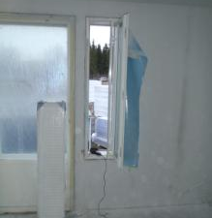
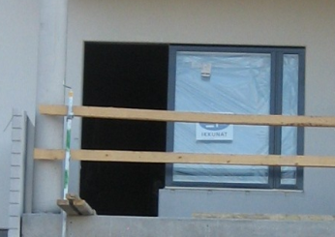
Ventilation in site
Threshold gaps and small passing troughs in technical installations are proper for site ventilation.
The air humidity of site is measured
Proper air humidity is adjusted by ventilating windows
Energy is wasted by opening balcony doors.
Opening
Ø160 mm
40-100 m³/h
Threshold
gap 5 cm
70-200 m³/h
Ventilating
window
0-2,000 m³/h
Door clearance
0-10,000 m³/h

Slide 10
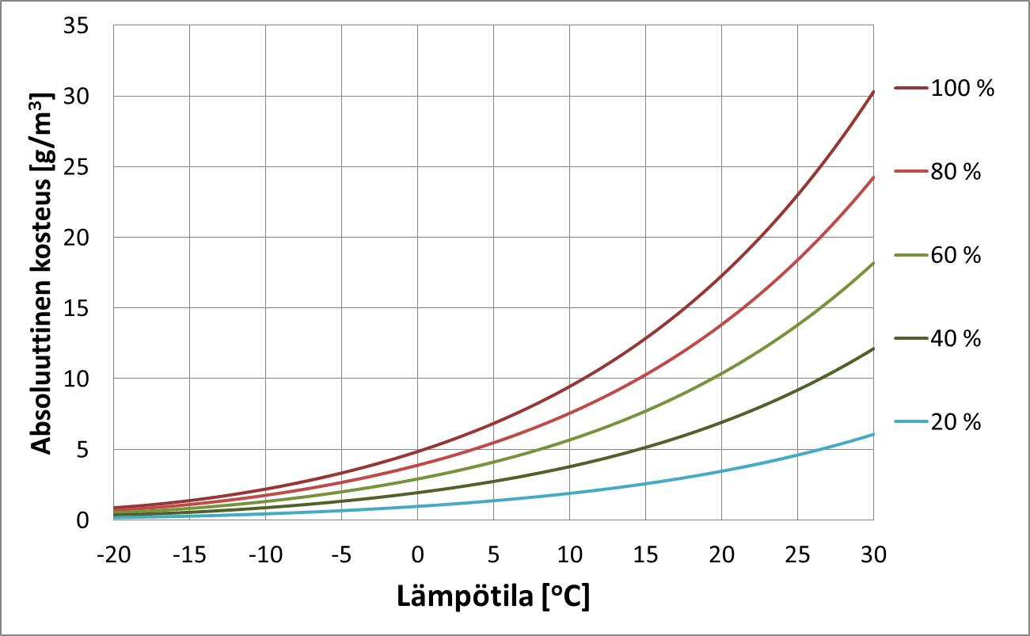
Exercise
How much water vapour can be released by ventilation of 10,000 m3 site of block of flats (about 50 apartments) when outdoor air and indoor air is exchanged once?
Inside temperature is 20ºC and outside temperature is 5ºC
Relative humidity inside the site is 50% and outside 80% .
Absolute humidity [g/m3]
Answer:
9 g–5 g x 10,000
= 40,000 g
= 40 litres
Temperature [ºC]

Slide 11
Sorption dryer
Drainage air is led through the rotating cell
Humidity binds to the surface of cell and is led out with airflow from drainage space
Sorption dryer works efficiently also at low temperatures
Sorption dryer reduces RH below 30%.
Sorption dryer may push dry air into structure or pull air out of structure
Sizing: air circulation 1-2 times the volume of the space
Use sub-contractor when volume exceeds 500-5,000 m³/h
Humid inside air is led out
Outgoing air to dryer
Humid air to dryer
Dry air is led to drainage space

Slide 12
Condensing dryer
The air is cooled to under the saturation point in dryer and water condenses in the evaporator.
Condensation dryer is suitable when temperature exceeds 15 ºC.
Water may be led directly into sewer
Energy efficient
Humid air
to the dryer
Evaporator
Dry air from the dryer
Condenser
Bucket and pump
Compressor

Slide 13
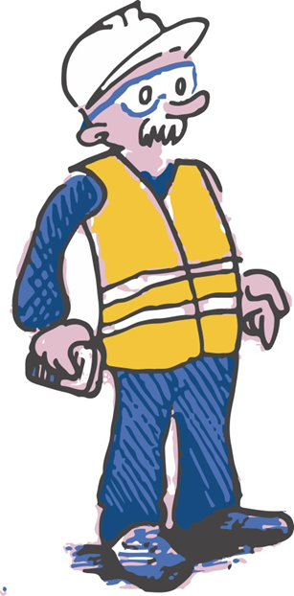
Apply ventilation for drying!
During winter, ventilating dries structures efficiently:
outside air is very dry when temperature falls below zero
by ventilating, humid inside air is led out and replaced by dry outdoor air

Slide 14
Thank You!

